Slide 1
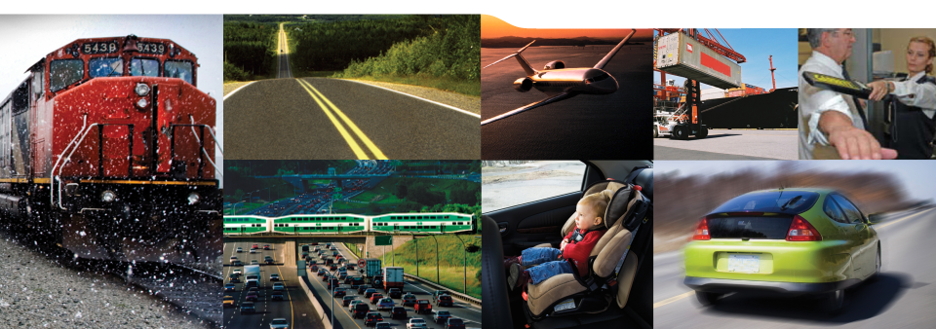
2018 Autonomous Vehicle Summit
April 4, 2018 Brookstreet Hotel, Ottawa
Emmanuel Chabot
Director, Innovation Policy
Transport Canada
Notes:
1

Slide 2
Technology is inspiring innovation…
  “We stand on the brink of a technological revolution that will fundamentally alter the way we live, work, and relate to one another.”
  – World Economic Forum
  “90% of the data in the world today has been created in the last two years alone.”
  – IBM
  “The Internet has revolutionized the way we communicate. Can you imagine what it can do for the supply chain? The Transport and Logistics Internet is coming…it is a game changer.” – Jeremy Rifkin, renowned economic and social theorist
  “I believe the auto industry will change more in the next five to 10 years than it has in the last 50…”
  – Mary Barra, CEO, General Motors
  “…new business models and technologies are emerging to solve the mobility challenge.”
  – McKinsey & Company
  “The transportation industry is on the verge of a massive software-driven market disruption, setting the stage for a significant change in the way we think about travel, city design, and transport more broadly.” – Marc Andreessen, Entrepreneur

Slide 3





… and transforming transportation
  Disruptive technologies have several common characteristics:
  The technology is rapidly advancing or experiencing breakthroughs
  Potential scope of impact is broad – touching many firms and industries and affecting (or creating) a wide range of products
  Significant economic value or welfare could be created
  Economic impact is potentially disruptive – changing the status quo in terms of market dynamics, daily life, or the nature of work
Connectivity
Automation
Internet of Things
Cloud Technology
Car of the Future
Adapted from McKinsey Global Institute

Slide 4
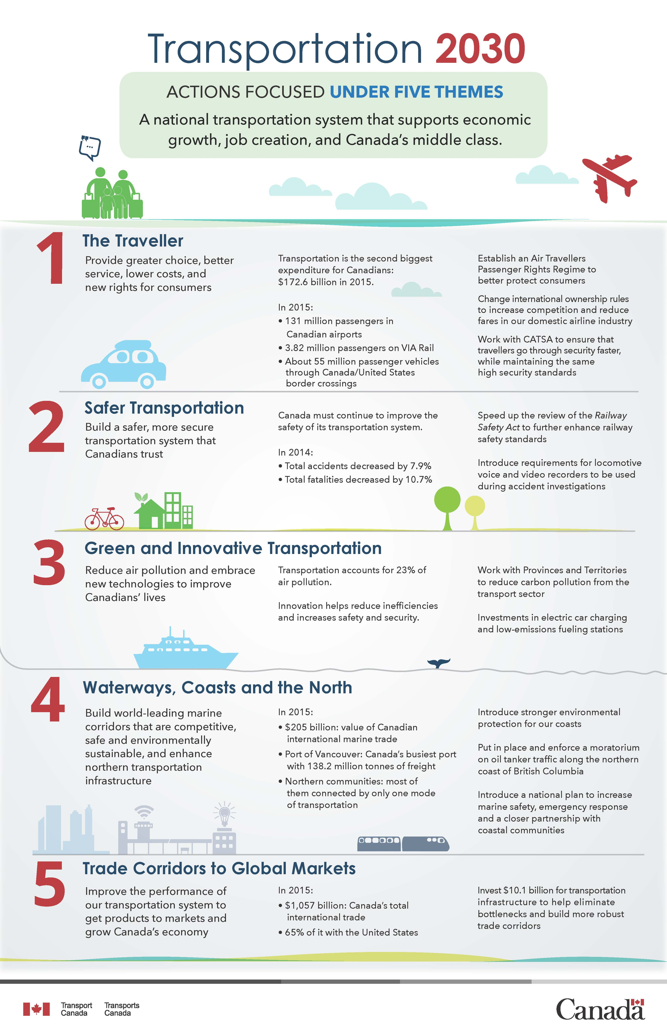

Slide 5


Slide 6
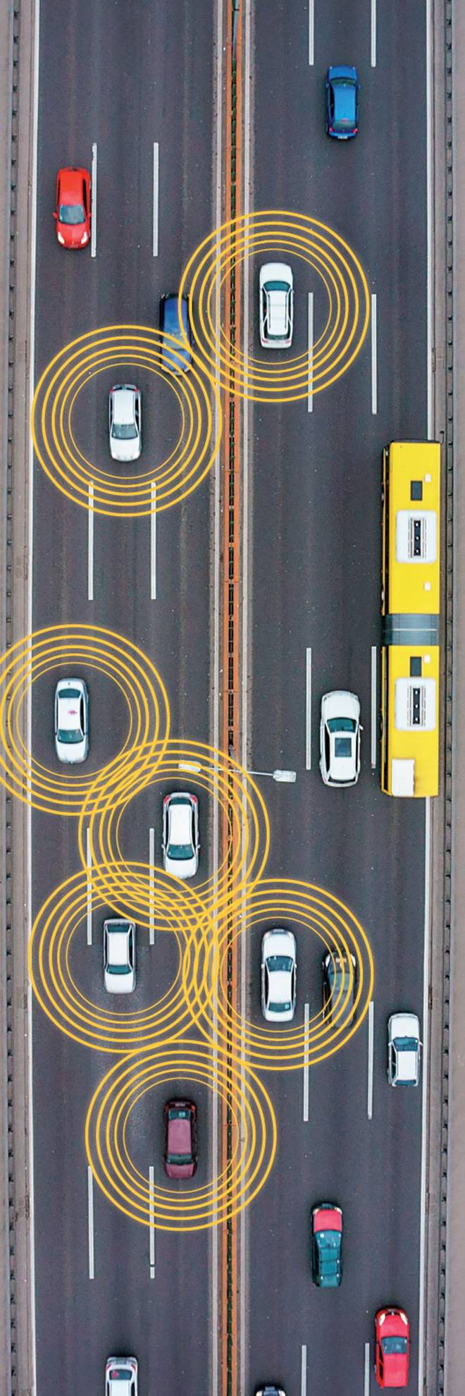
Program to Advance AV/CV Testing
  research/testing that identify solutions to AV/CV technical, policy or regulatory issues;
  the development of AV/CV codes, standards, certifications and guidelines; capacity-building and knowledge-sharing activities; and
  activities that identify and mitigate potential cybersecurity vulnerabilities

Slide 7
Forging a common approach across FPT jurisdictions
On January 29, 2019, the Council of Ministers Responsible for Transportation and Highway Safety endorsed a report The Future of Automated Vehicles in Canada
Key Recommendations:
Develop a National Policy Framework.
Align testing and regulatory frameworks across jurisdictions.
Continue to promote, test, and invest in AV/CV technology with industry and academia.

Slide 8
Important Considerations
January 29, 2018: Release of the Standing Senate Committee on Transport and Communications report, Driving Change: Technology and the Future of the Automated Vehicle
The report sets out 16 recommendations for the Government of Canada related to policy and regulation, safety standards, spectrum, cybersecurity, data privacy, R&D, a modernized MVTC, and skills and employment.
Regulatory Reform
Budget 2018 proposes to provide $11.5 million over three years, starting in 2018–19, for the Government to pursue a regulatory reform agenda focused on supporting innovation and business investment. The goal is to make the Canadian regulatory system more agile, transparent and responsive, so that businesses across the country can explore and act on new opportunities, resulting in benefits for all Canadians.

Slide 9
Concluding Comments
Innovation and Competitiveness
Attracting and developing Canadian talent; promoting the design and execution of advanced technologies; expanding and strengthening Canadian companies.
Safety
Safe and secure testing and deployment of innovative technologies; utilizing flexible policy and regulatory tools and standards; supporting technological innovation, regulatory alignment domestically and internationally.
Digital and Physical Infrastructure
Promoting the interoperability of AV/CV and ITS systems; upgrading digital and physical infrastructure; strengthening cybersecurity.
Data Privacy and Security
Privacy implications from Big Data Analytics; potential for data exposure following the development of new networks and technologies for AV/CV.
Social and Environmental Factors
Adoption and deployment of AV/CV; impacts to the labour market and environment.

Slide 10
Thank you!
  Contact information:
  Emmanuel Chabot
  Director, Innovation Policy
  Transport Canada
  Emmanuel.Chabot@tc.gc.ca

