Slide 1

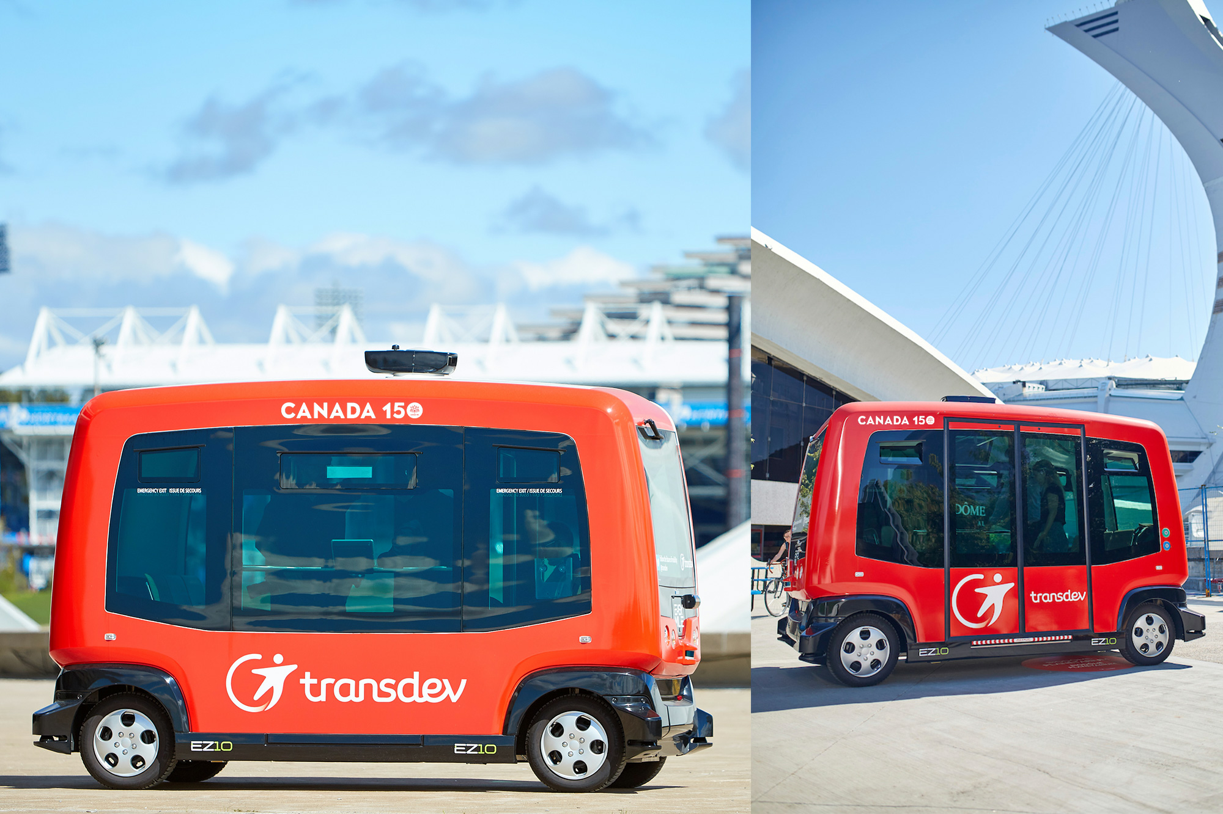
Smart Transportation
Transdev
Canada
Update May 2017

Slide 2
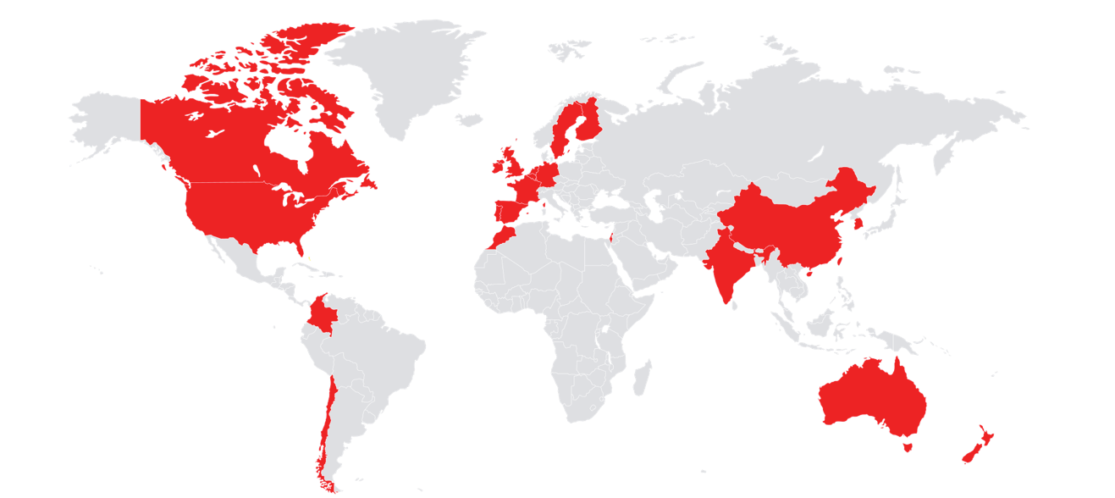
Global Leader in Public Transportation
19
Countries
100 +
Years of Passenger
Transport Experience
$8 B
Revenue
5
Continents
83 K
Employees
Notes:
Dick

Slide 3
Who is Transdev?

Slide 4
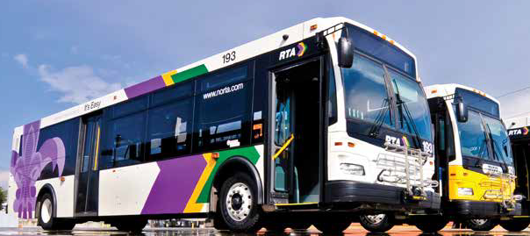
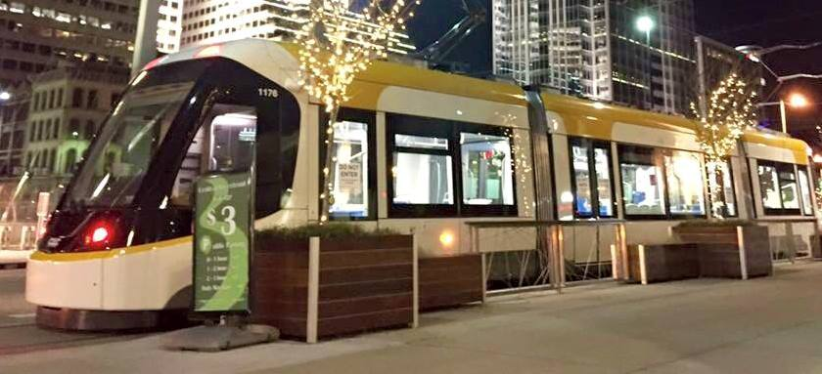



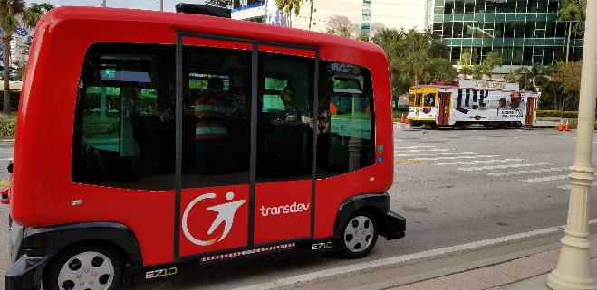
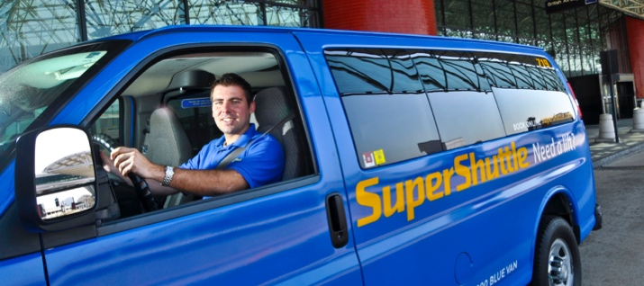

Who is Transdev?
Mobility service provider
  We use technology and innovations to improve to movement of people
Integrator of multiple modes of transport

Slide 5
Our vision of the future of mobility
P
A
C
E
PERSONALIZED
AUTONOMOUS
CONNECTED
ELECTRIC
Become really passenger centric
Develop full autonomous
Transport Systems
Develop MaaS (Mobility as a Service)
Be a leader for
Zero Emission
Notes:
Personalized public transport solutions
TeX: client experience by Transdev
Awarded 2016 Customer Relationship Award
Transdev is managing on demand solutions and expanding it in B2G
ChronoPro/France – Breng Flex/NL – Link/US
Autonomous solutions
Transdev’s ambition
Develop and operate a full Autonomous Transport System (including Dispatch & Fleet Control Command) in the shortest timeframe possible
Key objective
Capture value with a positioning allowing TD to control key elements for local authorities and passengers
First trials
First commercial contract in Civaux
Partnership with Renault-Nissan and Delphi to test AVs solutions in Saclay (EVAPS project) and Rouen
Connected solutions
Two priorities for our MaaS strategy
Development of the different bricks of service required for MaaS:
Cityway trip planners Lyon, Toronto,
Mobile ticketing
Key CRM skills in our B2C markets
Push MaaS solutions
Electric fleet management experience
Extensive test of eBus in real and pre-operations
Test of full electrical solutions; Living Lab eBus
Two major contract wins in the Netherlands
Zuid Oost Brabant: Progressive shift from 43 eBus at contract start in 2016 to 200 by 2024
AML:260 eBus in operation by 2021 (90% of the fleet) – 100 by the end of 2017

Slide 6

PACE

Slide 7
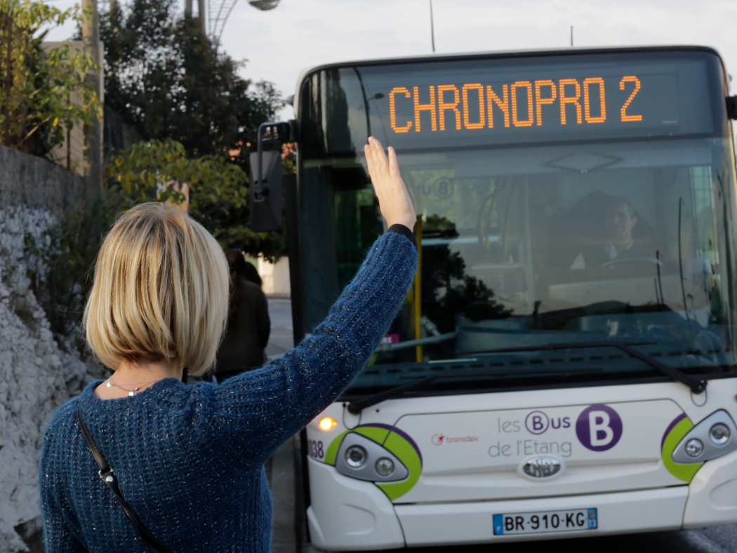
Personalized
Providing the best mobility solution for each of our clients
Investment in on-demand transport solutions
B2C
B2B
B2G
  Chronopro :
  + 42% passengers
  -48% travel time
  -84% KM
TeX: client experience by Transdev
2016 AFRC
Customer Relationship Award

Slide 8

PACE

Slide 9
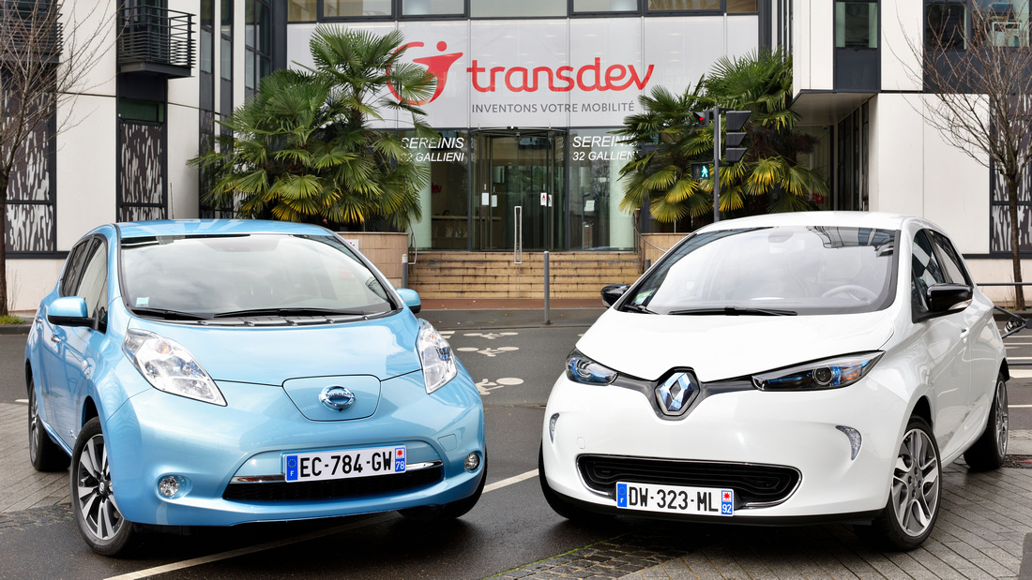
Autonomous
Bring the best of autonomy to shared mobility (safety, last mile solution, free
time, urbanism)
Operations and experiments of shuttles in protected areas:
Civaux (1st commercial contract), Issy-les-Moulineaux, Rungis, USA, Australia
In Canada: Montreal and Ottawa
Partnership with
the Renault Nissan Alliance to develop ATS level 5
AV Technology, leverage Transdev URE

Slide 10






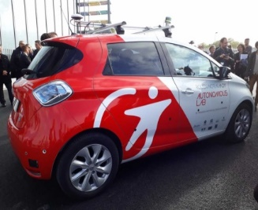
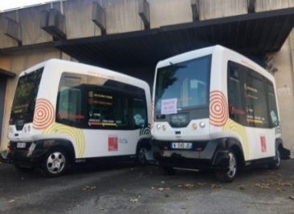
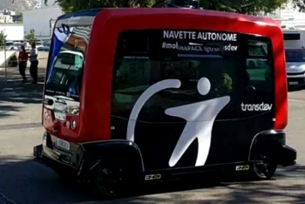
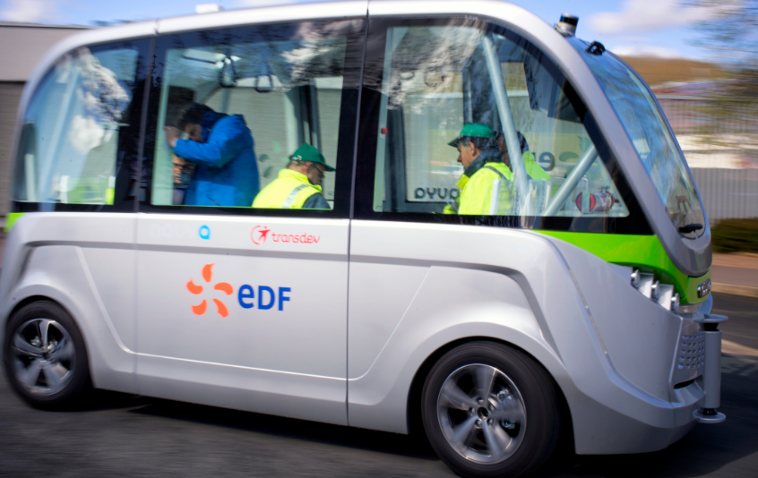
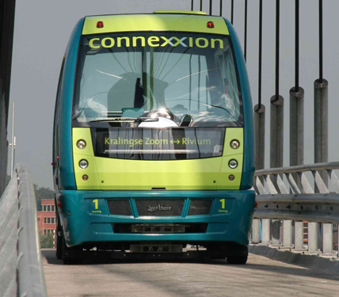
Key Autonomous Commercial Deployments
Exciting Deployments
1st contract in US
Contract in a new solar city in Florida
A scalable service to accompany the development of the city
Open road
On demand
ROUEN NORMANDY Autonomous Lab
4 Renault Zoe
Autonomous fleet in commercial operation in
a Nuclear Plant in Civaux/France
Transport of employees in a nuclear plant
OPEN ROAD with connected lights!
2 vehicles operated in a business center
First autonomous fleet in commercial operation in Europe
Since 2005
1,8 km linking metro station to a business park
Added Jacksonville Florida
Added Gainesville Florida

Slide 11
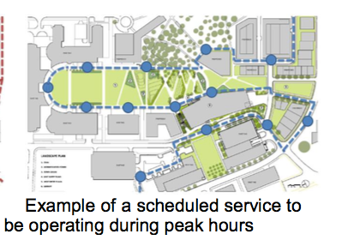
Work Plan: Operations
Version 1 “Metro Mode”
Two vehicles in operation at all times with 10-minute headway, making all stops
  Average speed (including all Marion Street stops) of 4.2 MPH
  While moving the vehicle will average between 8 and 12 MPH
  EZ10 is capable of a maximum operating speed of 24MPH

Slide 12
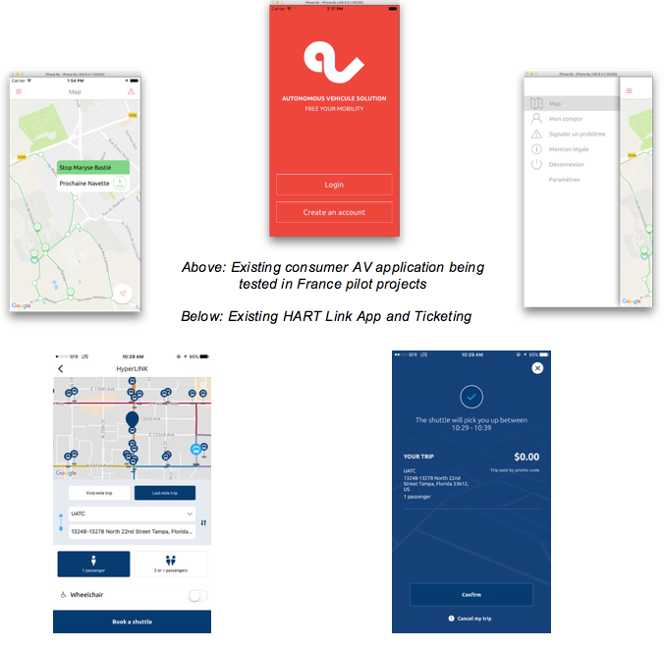
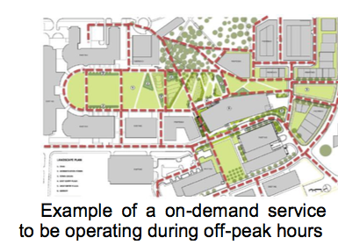
Work Plan: Advanced Operations
Version 2: “Bus Mode”
Transitioning operations to “elevator mode” allows the vehicles to move through stops where no passengers are getting off

Slide 13
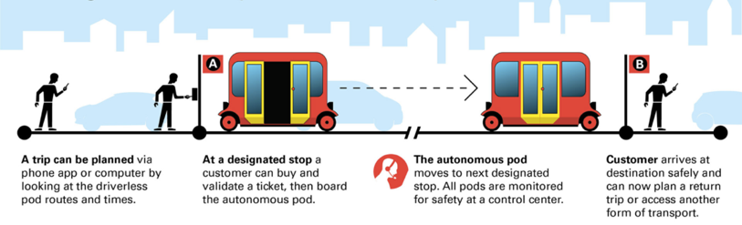
Work Plan: On-Demand User Experience
Version 3: “On-Demand Mode”

Slide 14


System Safety
Full Hazard and Risk checklist
Testing against this checklist
Modify checklist as technology improves on ADS
Safety KPI’s and measurement
Safety policy and procedures
Testing for all safety checklist items
Notes:
Robust design and validation process based on a systems-engineering approach with the goal of designing ADS’s free of unreasonable safety risks.
Design and validation process should als consier including a hazard analysis and safety risk assessment for Ads
Design decisions should be linked to the assess risk that could impact safety critial system functionality
All design decision's should be tested, validated and verified as individual subsystems

Slide 15





Operational Design Domain
PACE
    Current Design Domains
    Roadway:
      City and town streets
      Sidewalks, parking lots, gravel roads
    Speed:
      Urban speed vehicles
      Non-Highway speed
    Weather:
      Sunny and Cloudy
      Medium rain conditions
      Medium snow conditions
      Light Fog
      Extreme Cold
      Extreme Heat

Slide 16

Vehicle Cybersecurity
Cyber Management:
  ADS – segregation from the rest of the on-board network.
  Mapping managed only on vehicle
  Routing and dispatch separate for ADS. Link to new routing algorithm encrypted and managed to ADS communication link
  Routine test hacks
  Work with government entities to test ADS/vehicle hacks

Slide 17

Data Recording
Data Focus:
  Efficiency of the vehicle
  Issues or incidents identified
  Battery performance
  Breaking and acceleration
  Number of passengers
  Others…
Command Center
  Monitor vehicle
  Health and Well Being
Notes:
Learn from crash data
Analys of crash involving a single ADS could lead to safety developments and subsequent prevention of that crash scenario
Data should be collected for on-road testing and use and entitites should adopt voluntary guidance, best practies, design pricinpa and sta
Promote a continued learning environment

Slide 18

PACE

Slide 19



Connected
Create an Open “internet of mobilties” (IoM)
Launch open-data of “Catalogue”, open-source platform for mobility data
First public transportation data available
Continued investments
in MaaS global (Whim)
to develop “Mobility
as a Service” solutions
Beta version launched in Helsinki - Fall 2016
Moovizy, first step towards
a mobility “as a service”
in Saint Etienne, France

Slide 20

PACE
MaaS – Babcock Ranch
Focus on testing MaaS programs
  Passenger pickups
  Bicycle Program
  Car Rental
  Shuttles from Airport to Babcock
  Shuttles from Babcock to sites
  Shuttles from Babcock public transportation
  Grocery delivery

Slide 21

PACE

Slide 22

Electric
Foster a Zero Emission mobility
“E.bus Living Lab” with
our clients & partners
Creation of an exclusive toolbox to size and operate 100% electric fleets
Transdev operates 2 majors Zero Emission public transportation contract:
Eindhoven
Amsterdam/Schiphol
  More than 160 electric buses to be operated by Transdev in the Netherlands - Fall 2017

Slide 23
Thank You
23

Slide 24

24

