Slide 1
Overview of TC’s Program to Advance Connectivity and Automation in the Transportation System (ACATS)
Ottawa AV Innovation ‘201’
May 22, 2018

Slide 2
ACATS Program Overview
Preparing Canada for the Safe and Secure Deployment of Connectivity and Automation in Road Transportation
Information Clearinghouse
Connectivity
Automation
Cybersecurity
Digital Infrastructure
Policy & Planning Resources
Tools & Guidance
Highly Qualified Personnel
Knowledge Dissemination
Enabling Technologies & Systems
Codes, Standards, & Certification
Governance
Training & Education
Research, Analysis, & Testing
Capacity Building
Notes:
A central agency for the collection, classification, and distribution especially of information; broadly
https://www.merriam-webster.com/dictionary/clearinghouse
Digital infrastructure – data/virtual
ICT infrastructure – physical,
The following definition summaries the concept of Digital Infrastructure: “static and dynamic digital representation of the physical world with which the automated vehicle will interact to operate. This includes sourcing, processing and information”.
http://cordis.europa.eu/docs/projects/cnect/7/610737/080/deliverables/001-D361DigitalInfrastructure.pdf
establish a federal Centre of Expertise (CoE) on Connected and Automated Vehicles within Transport Canada
establish a CV/AV community of practice to guide and support P/T technical, cybersecurity and regulatory readiness
provide Grant & Contribution funding to support:
research and studies to identify solutions to mitigate CV/AV technical, policy or regulatory issues;
the development of codes, standards, certifications and guidelines necessary to deploy CV/AV technologies in Canada; and,
research and testing activities to identify and begin to mitigate potential cybersecurity vulnerabilities.

Slide 3
Key Priority Areas
Notes:
Some examples of the work we are doing to address a few of these challenges

Slide 4
Security Credential Management System (SCMS) – Functionality
Every CV transmits a BSM 10 times/sec with position, speed and heading, while other CVs in proximity “listen” for, and analyze, each incoming BSM to assess possible crash threats and issuing driver warnings as needed.
Each BSM must be trusted for system to work.
SCMS is designed to ensure :
BSM authenticity – received from a device authorized to participate in CV system
BSM integrity – message was not altered in transit
System must be able to blacklist bad actors (e.g., defective equipment or malicious behavior).
System must not compromise end user privacy, (i.e., prevent collection of information that could directly or indirectly identify a person or vehicle or allow trips to be tracked).
The solution must be scalable (e.g., up to 400M users), extensible to all possible devices types and applications, and allow for interoperability.
The solution must be financially sustainable.

Slide 5
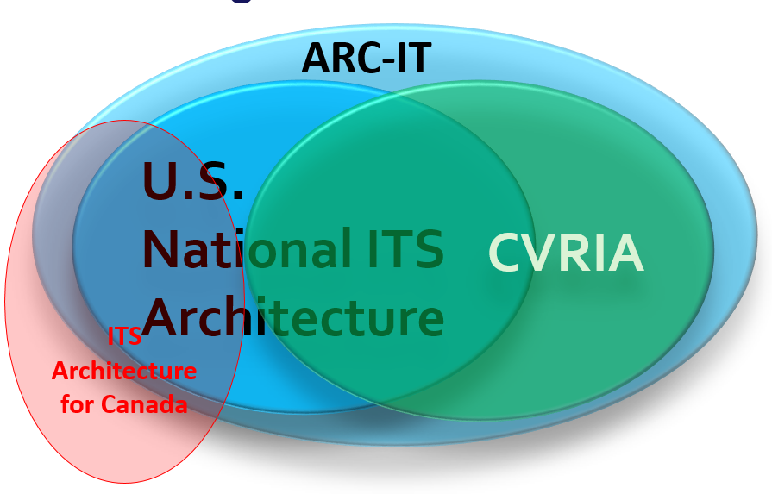
Interoperability - ITS Architecture
A common framework for planning, defining, and integrating ITS deployments
Will be essential for V2I
ITS Architecture for Canada
Version 1.0 developed in 2001 based on version 3.0 of the U.S. National ITS Architecture
Version 2.0 released in 2008, aligned with U.S. version 6.1
No longer fully aligned with US architecture
Image credit: Geoff Knapp, WSP
2017 TAC Stakeholder Outreach – Survey of Canadian Stakeholders
Responses showed interest for continued Architecture support
Notes:
The ITS Architecture for Canada (Version 1.0) was initially developed in 2001 based on the then current Version 3.0 of the U.S. National ITS Architecture. It represented a significant step in the advancement in promoting the interoperability of ITS within Canada and across North America. The ITS Architecture for Canada was last revised in 2008 and is currently hosted by the Transportation Association of Canada (TAC). Last winter, TAC commissioned a study to assess a need for, and stakeholder interest in, updating the ITS Architecture for Canada (currently Version 2). Overall stakeholder response indicated a need for a Canadian ITS architecture that is aligned with the US ITS architecture, but work is needed to bring it up to date, make it more user friendly, and improve training resources.
Since 2008, the U.S. National ITS Architecture has been revised twice to version 7.1, and a separate architecture for CVs was developed - the Connected Vehicle Reference Implementation Architecture (CVRIA). The National ITS Architecture and CVRIA were recently merged into a single architecture, now called the Architecture Reference for Cooperative and Intelligent Transportation or ARC-IT version 8. USDOT is hosting two free public workshops – in July and August - to seek stakeholder feedback on the content and usability of ARC-IT version 8.
2017 Stakeholder Outreach – Survey of Canadian Stakeholders
Responses showed interest for continued Architecture support
Considered:
Need to support Canadian unique services
Need to support Canadian spelling
Need for aligning with US
Frequency of updates
Governance model

Slide 6
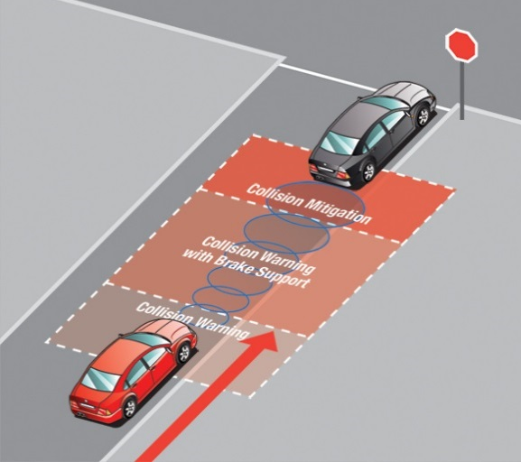
Other Work at Transport Canada
Monitor vehicle technology and assess the performance and potential benefits of crash avoidance systems for Canadians e.g. Automatic Emergency Braking
Conduct research to identify and address human factors needs in motor vehicle safety
Guidelines under development:
HAV testing guidelines for trial organizations
Canadian jurisdictional guidelines for safe testing and deployment
Amendments to Motor Vehicle Safety Act

Slide 7
Final Thoughts
Connected and automated vehicles have many benefits to offer Canadians:
Safety
Mobility/Quality of Life
Transportation System Efficiency
Economic Stimulation
Interdependency of vehicles and infrastructure
To capitalize we must work together to ensure safe and effective deployment solutions for Canadians

Slide 8
Thank You
For more information, please contact:
Matt Krech, P. Eng.
Senior Program Engineer
Program to Advance Connectivity and Automation in the Transportation System (ACATS),
Transport Canada,
Place de Ville, Tower C
Ottawa, Ont. K1A 0N5
Tel: (613) 991-3419
matthew.krech@tc.gc.ca

