Slide 1
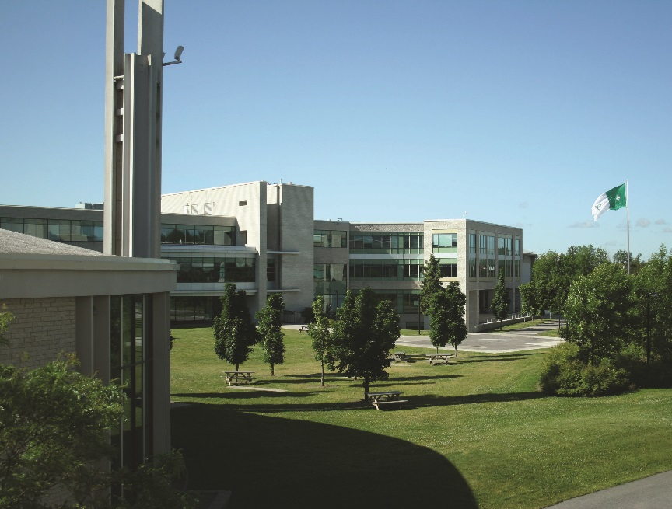
Ottawa AV Innovation at Work:
Research Leadership
May 22, 2018
La Cité

Slide 2
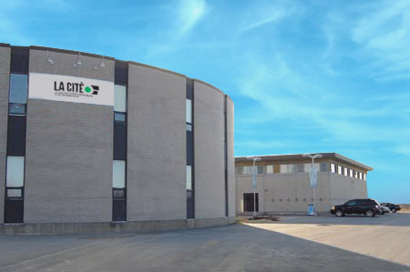
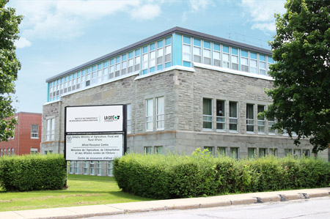
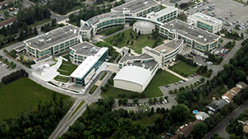
Creating autonomous systems and capacity in Eastern Ontario and Western Québec
CAMPUS ALPHONSE-DESJARDINS, ORLÉANS
CAMPUS DE HAWKESBURY
LA CITÉ À ALFRED
LE CAMPUS PRINCIPAL DE LA CITÉ

Slide 3
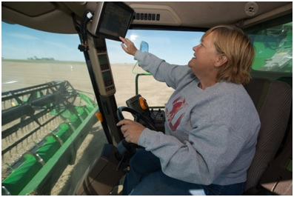
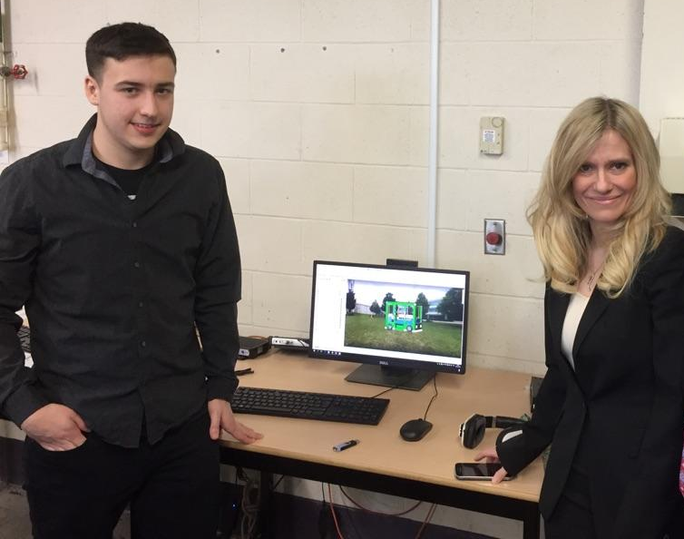
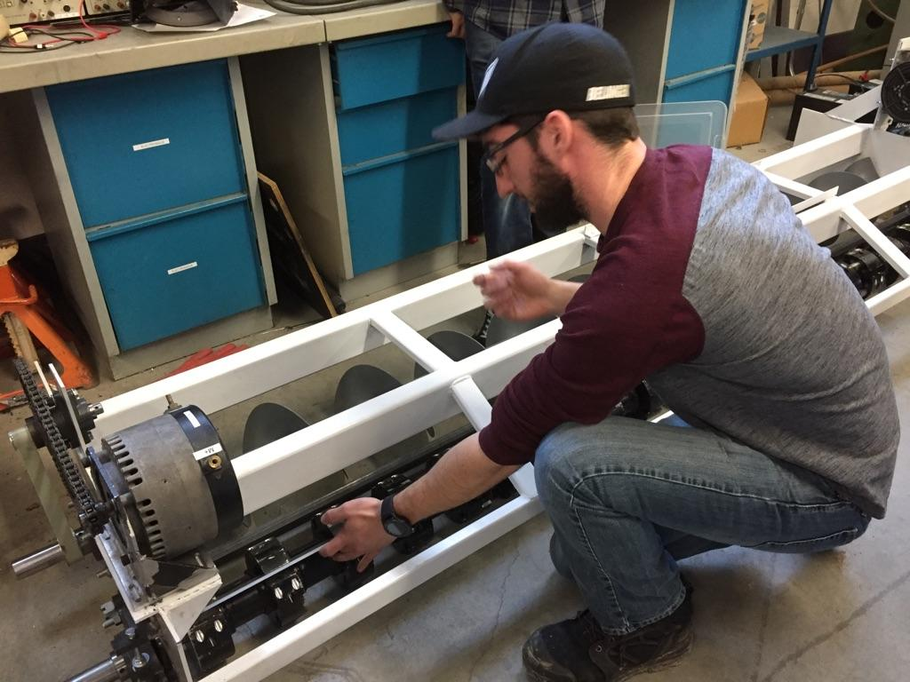
Smart City
Smart Country
Vehicles
Buildings
Agriculture
Safe, secure cyber infrastructure
Centre of Excellence for Smart Prototyping (CESP),Centre d'expertises en prototypages intelligents (CEPI),
NSERC, OCE and others,
Transformation 2020
AVIN – autonomous vehicles and infrastructure
CENGN – 5G and Software defined networks
ENCQOR – 5G Corridor
Invest Ottawa MadeMill
Strategic Partnerships with private sector and academia

Slide 4
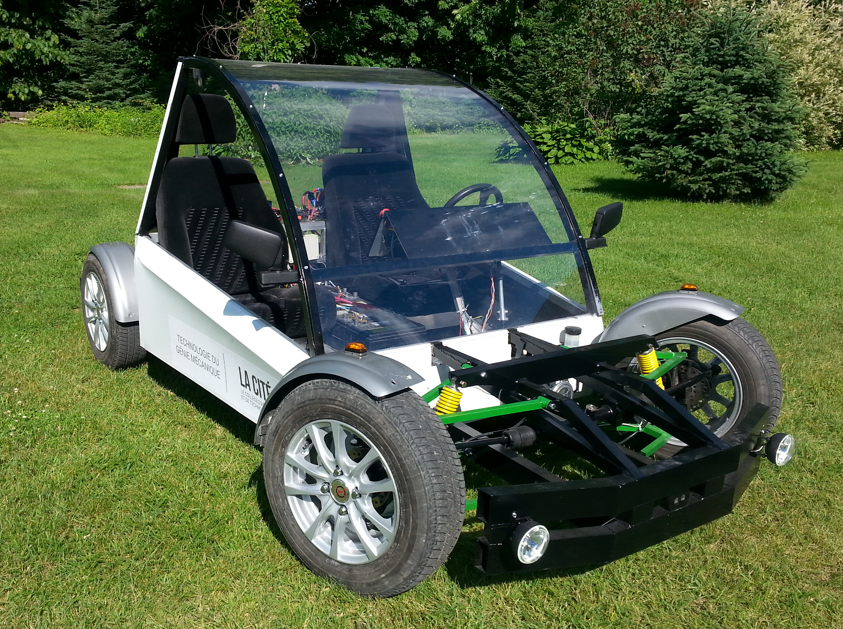

Slide 6
Electric wheel

Slide 7
Autonomous Shuttle Bus

Slide 8
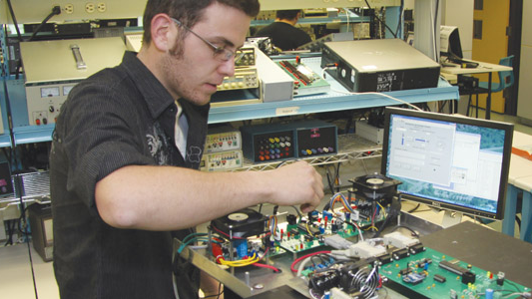
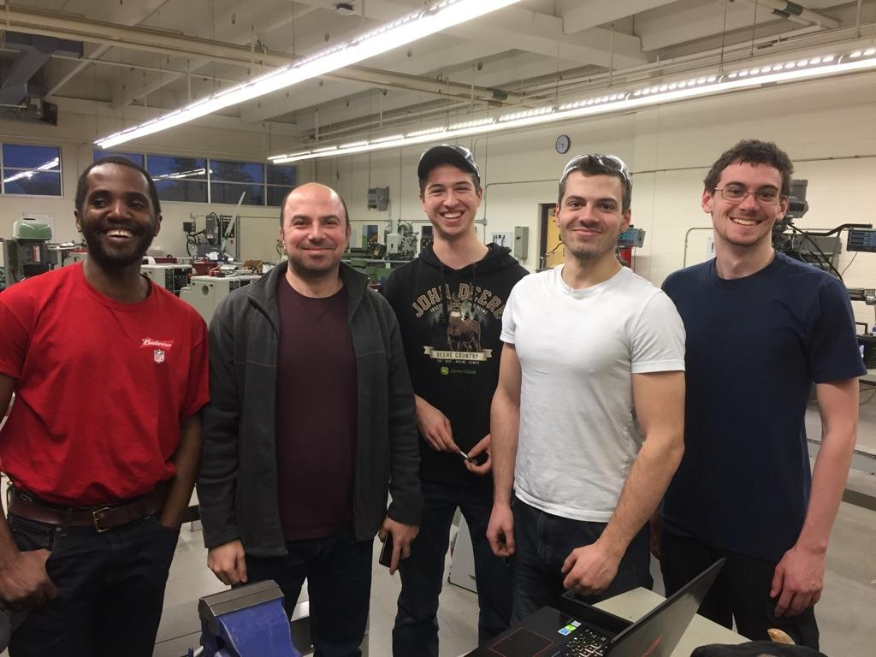
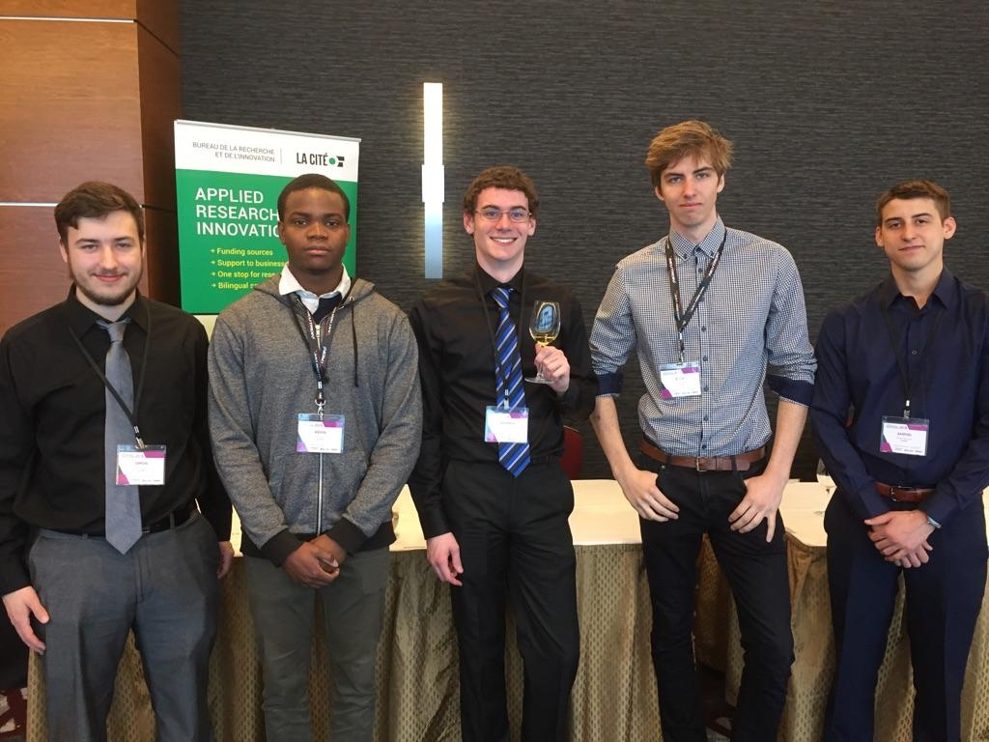
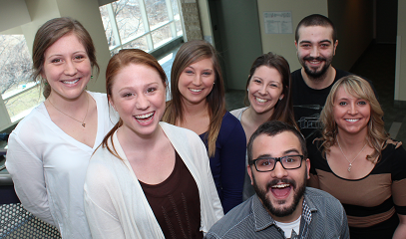
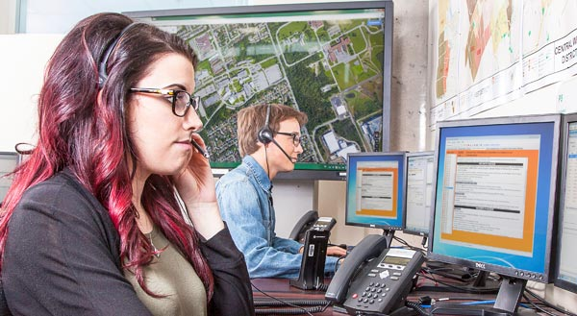
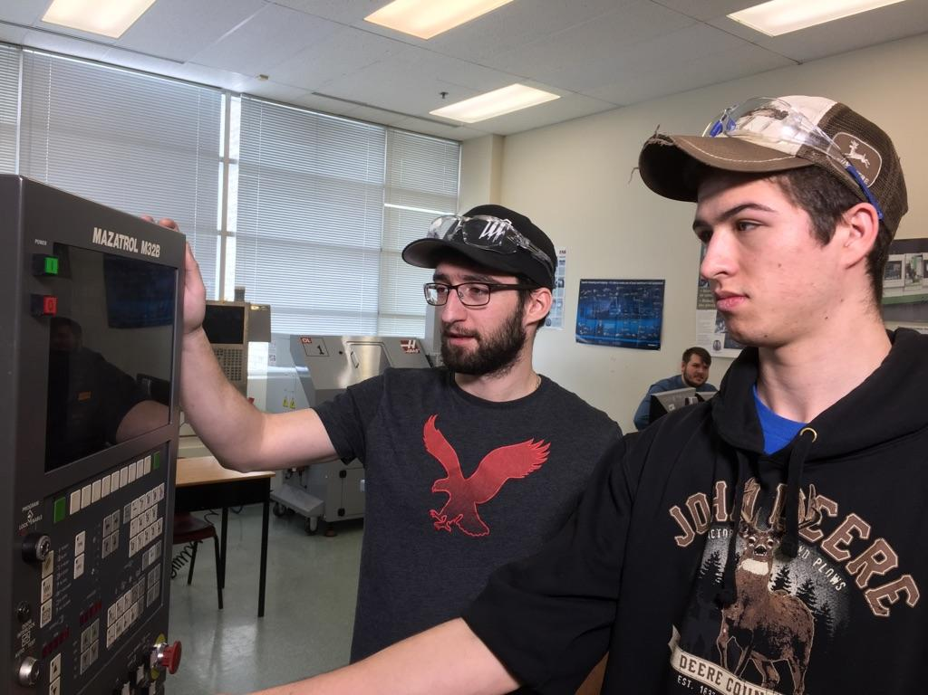
Centre d'expertises en prototypages intelligents (CEPI)
Centre of Excellence for Smart Prototyping (CESP)
Applied Research into the Integration of
Smart System Prototypes
Software
Cyber-security
Sensors
Networking
Mechanical
Electronics
Power
Architecture
ICT
Wireless
Biotech
More…
Team work
Industry projects

Slide 9
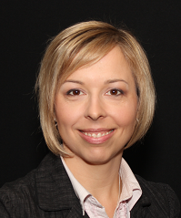
Thank You
For more information visit:
https://research.collegelacite.ca/home/
Or contact the staff the Office of Applied Research
and Innovation
Nathalie Méthot, Ph.D
Manager
nmetho@lacitec.on.ca
Charles-André Massebeuf
Partnership development advisor
chmasse@lacitec.on.ca

