Slide 1


SMARTCONE TECHNOLOGIES
Making safety possible anywhere, anytime.

Slide 2


Working together for safer and smarter cities
Vision Zero is a traffic safety policy based on four elements: ethics, responsibility, a philosophy of safety, and creating mechanisms for change.

Slide 3
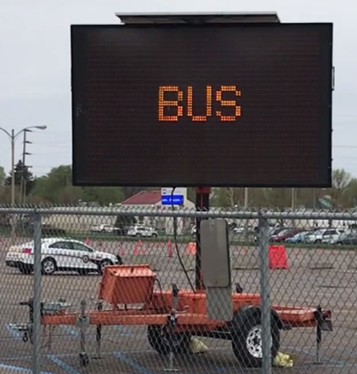
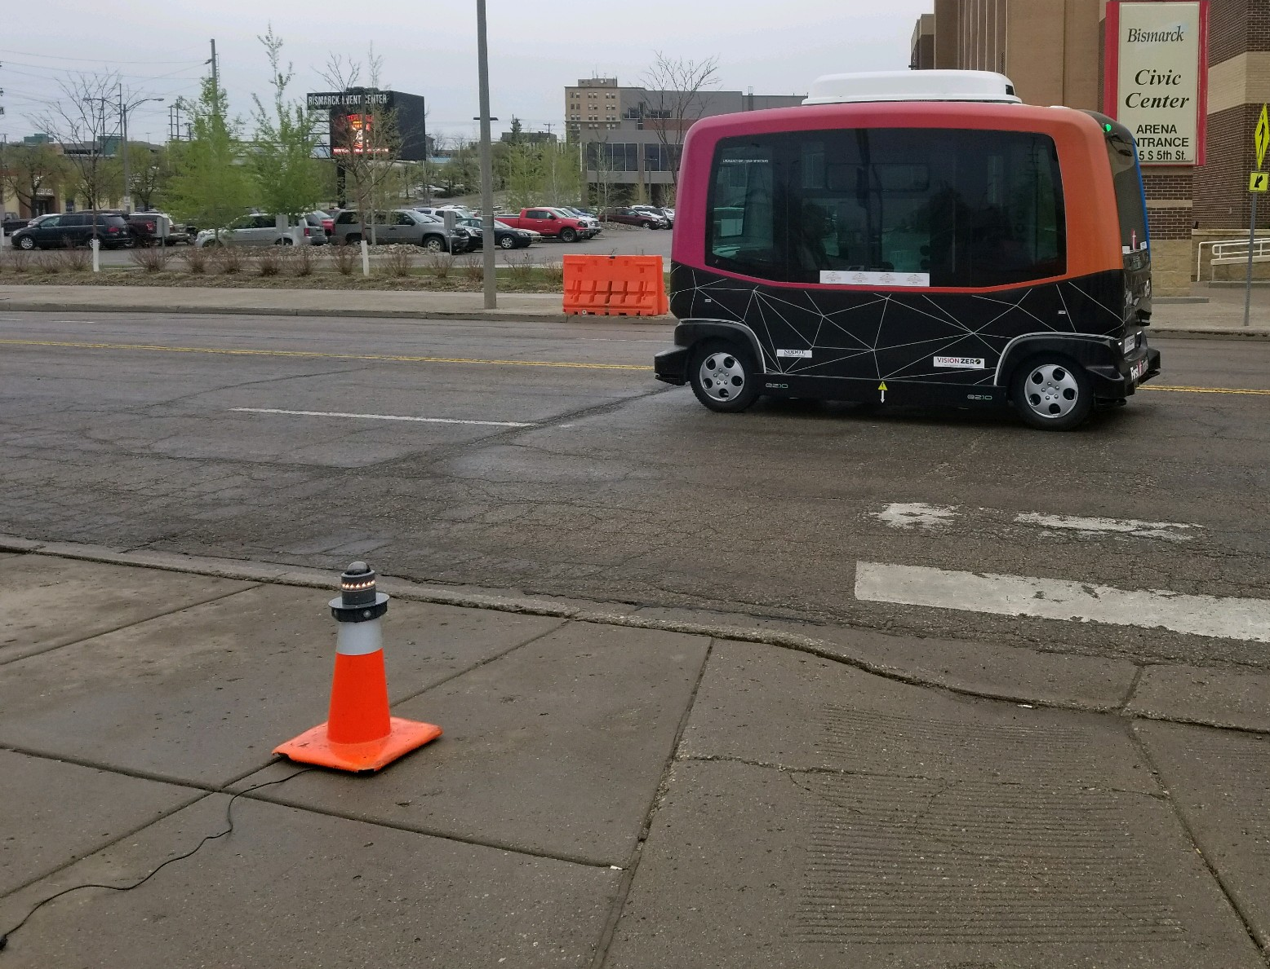
Autonomous Bus Event - North Dakota
SmartCone detected pedestrians and an autonomous vehicle at the same time using sensors sharing data in real-time between multiple SmartCone devices
SmartCones were placed on the sidewalk, in the vehicle and on the traffic sign.
The alarm data was transmitted to the Traffic Sign using MQTT and NTCIP where a message was displayed

Slide 4
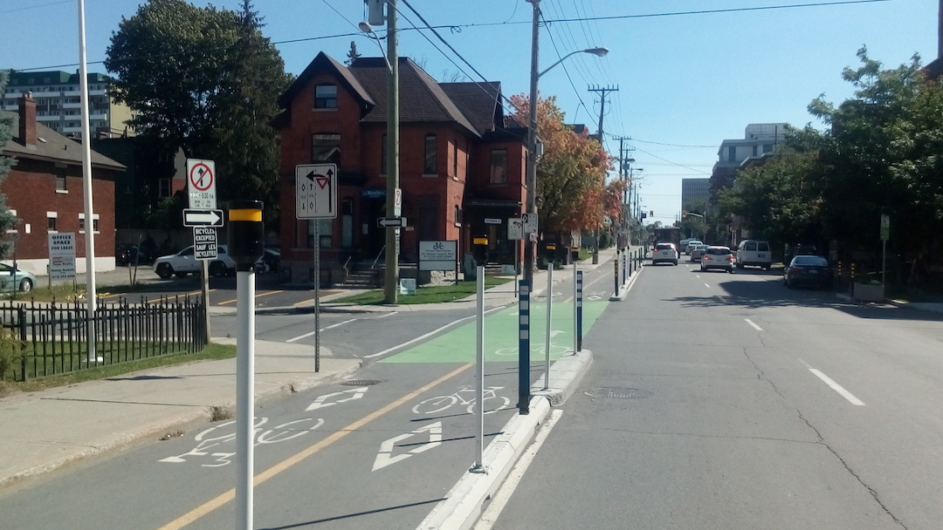
City of Ottawa Bike Lane Project
Notes:
Useful for NON-SIGNALIZED INTERSECTIONS.

Slide 5
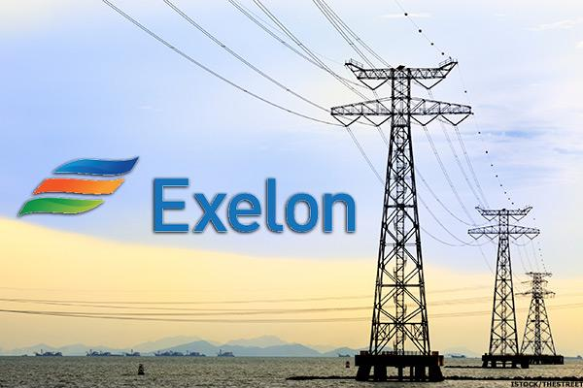






Key Partners / Customers
Enterprise - Phoenix Sky Harbor

Slide 6
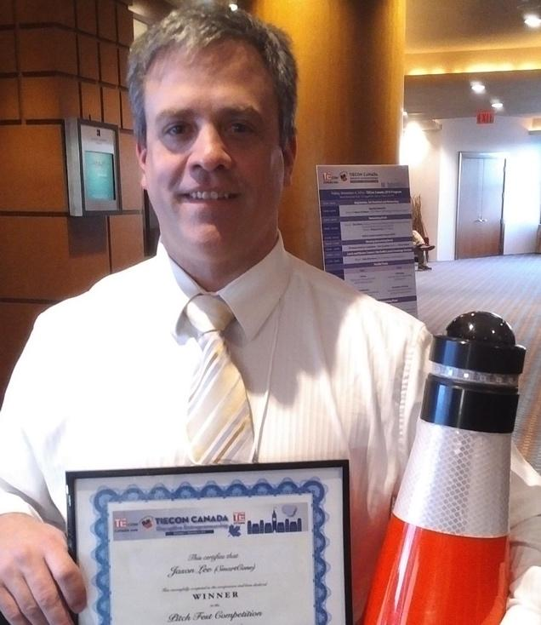
We are honored to be part of it
TieCon Pitchfest Winner 2016
NextEnergy SmartCity Winner City of Detroit 2017
Signed Joint Initiative Agreement with IBM in 2017
Successful Portable Autonomous & Pedestrian Detection System Trial 2018

