Slide 1

Ottawa AV Innovation ‘201’
Changing the way traffic moves

Slide 2

Mission
Provide real-time vehicle traffic congestion information to allow dynamic routing decisions on roadways and across ports & borders
We are a technology company developing a Smart Vehicle Traffic Platform that utilizes our hardware sensors (inside/outside the vehicle) as well as Machine Learning & Artificial Intelligence algorithms to generate actionable traffic analytics data for better monitoring and management of congestion

Slide 3

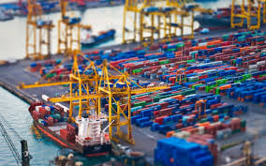
Problem/Opportunity
Traffic congestion delays cost money in productivity, driver stress, air & noise pollution
  access to real-time traffic congestion information very limited
Traffic inefficiencies at the Ports results in loss of productivity, decreased capacity and reduced revenues
  vehicles congestion data not readily available at ports/terminals

Slide 4
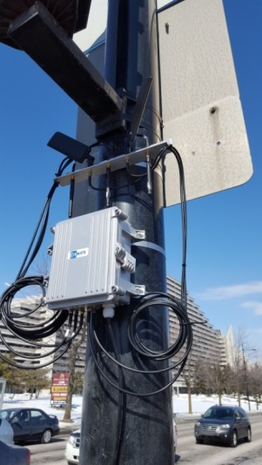
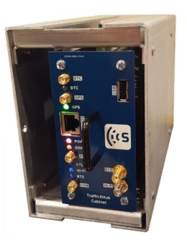
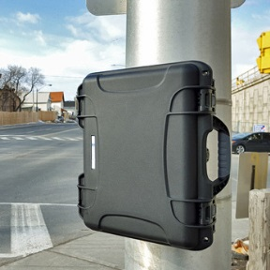
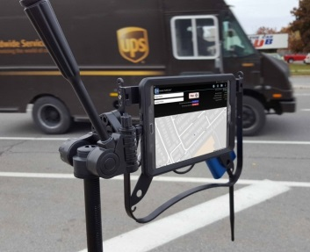
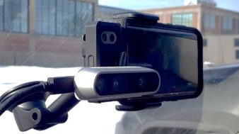
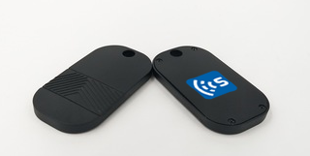
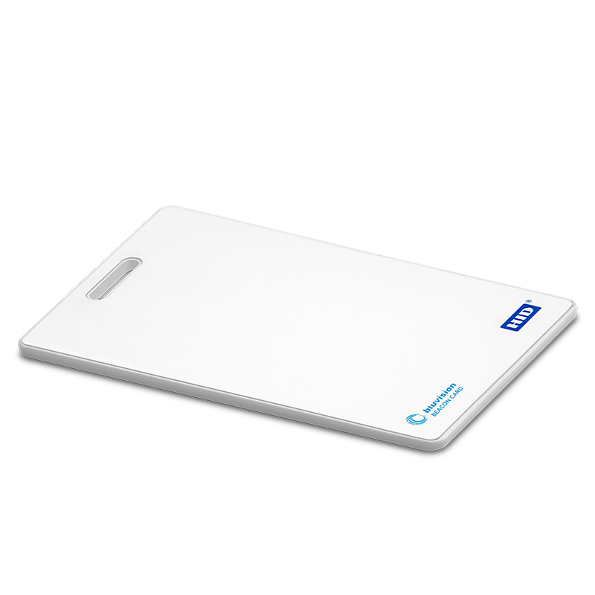
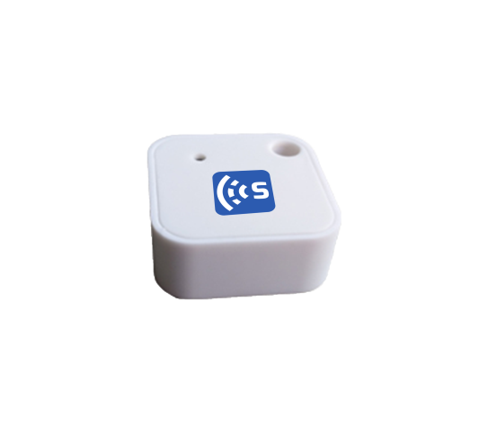
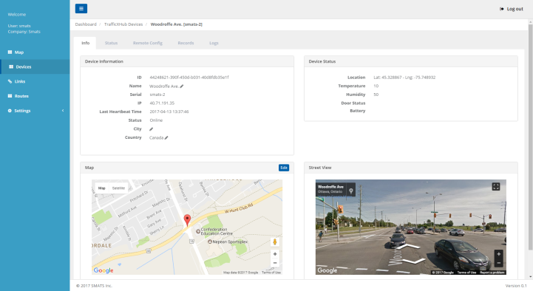
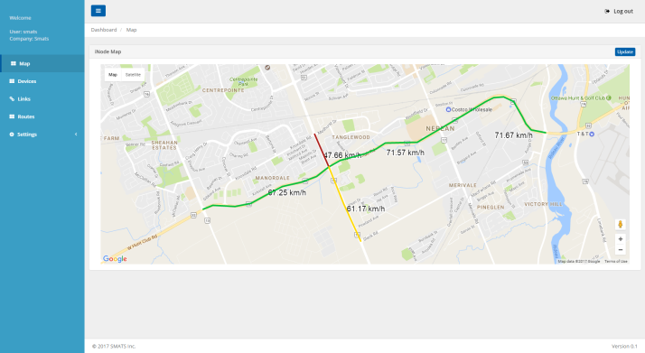
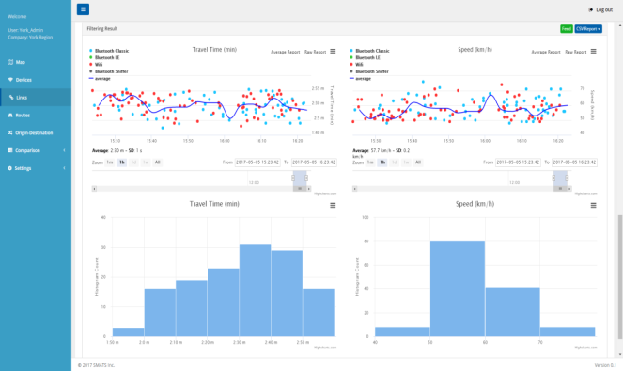
Our Products
Roadside Sensors
In-vehicle Sensors
TrafficXHub
(Permanent Detector)
TrafficXHub - Cabinet
(Permanent Detector)
TrafficBox
(Semi-Portable Detector)
TrafficTab
(Portable Detector)
TrafficMini
(Occupancy detection)
Bluetooth/RFID Tags
(Vehicle tagging)
(Our iNode™ Analytics Engine in the Cloud or on-premises)

Slide 5






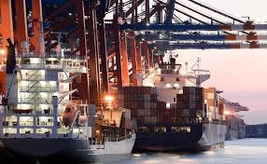

Our Customers
Cities and Municipalities
Universities
Ports
Consulting
Shiran surveys and research LTD
Ports
Truck gate wait-time
Truck in-terminal wait-time
  Roads
  Travel Time
  Origin-Destination
  Signal Optimization
Borders
Current wait-time
Predicted wait-time

Slide 6
Autonomous/Connected Vehicle - Vision
Support service requests from on-board trucks dashboard
  Electronic Data Logging (EDL) & wait time notifications
  Share occupants info using our onboard “smart mirror” device
  Diagnostics (fuel consumption etc.)
  Road conditions, driver’s status (Fatigue, Drowsiness etc.)
Connect with roadside infrastructure - vehicle-to-infrastructure (V2I)
  Utilize our roadside sensors
  Safety of Rural Roads intersections – measure Time-To-Collision
  Enable secure transportation of cargo – using “smart contracts” via Blockchain
  Support “Truck platooning”
Based on National Highway Traffic Safety Administration (NHTSA), we plan to support level 0 to level 3 of AV

Slide 7

Thank You
Smart Traffic Solutions

