Slide 1


Slide 2









We create the technology to connect the world
Global leader in connectivity solutions
for telecom services providers and enterprises
2017 revenue: € 23.1 B (≈ C$ 36 B)
2017 R&D: € 4.5 B (≈ C$ 7 B)
Employees: 103,000
R&D: 38,000
Services: 40,000
Countries where we operate: 100
Mobile connectivity: 4G/LTE evolution and 5G
Terabit IP/MPLS routing and optical networking
Fixed network access: copper, cable, fibre
Applications & analytics
Nokia Technologies: brand licensing, digital health
Nokia Bell Labs
In Canada:
~$1.5B investment in R&D over the past 5 years
In Ottawa: Nokia’s Kanata campus, March Road
Employees: 2,300
Office space: 52,200 m²
Global motherhouse for Optical Networking & Cybersecurity
#2 global R&D centre for IP networks
Mobile networks
Fixed network access

Slide 3
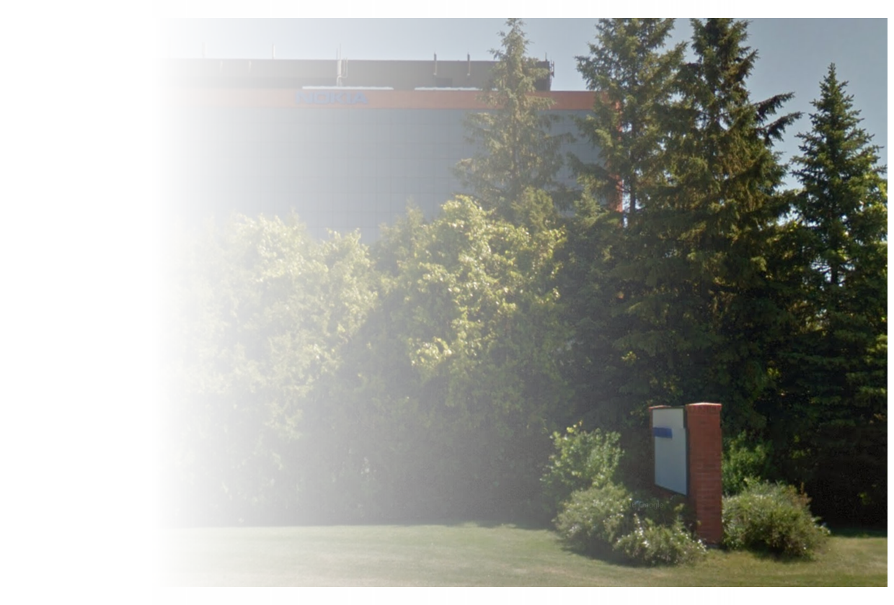




History of Engineering Excellence in Ottawa
1990
2000
2010
Today
#1
Managed T1/E1
Bandwidth Services
#1
ATM Multiservice
Wide Area Networks
#1
IP/MPLS
Mobile Backhaul
Diversified Technology Base
IP & Optical Networks
Fixed Networks
Applications & Analytics
Carrier SDN & Virtualization
Nokia Confidential

Slide 4

(km)
Speed
of Light
1000
100
Connected
Industries
Connected
Cities
Connected
Health
Connected
Safety
Connected
Agriculture
Connected
Automotive
10
4G/LTE and 5G C-V2X
0.1
1
10
100
Round Trip Time (milliseconds)

Slide 5
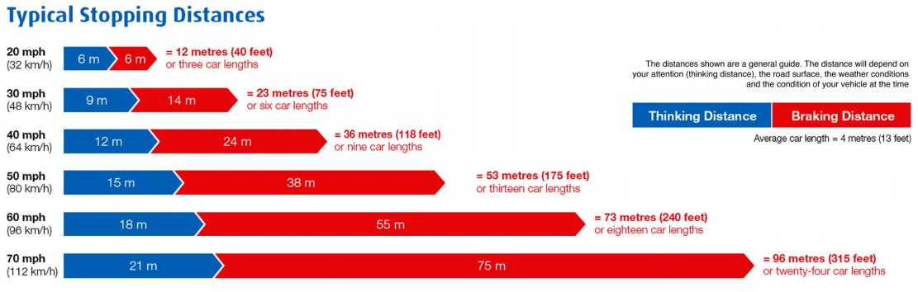
500 ms
Approximately 5 s
All processing in the vehicle including any alert information from the network
End-to-end latencies:
LTE: 100s of ms
LTE with MEC: 10s of ms
5G with MEC: 1s of ms

Slide 6


C-V2X Vision: LTE with 5G Evolution
Parking
NB-IoT
LTE V2N
(via core)
LTE V2N
(via core)
Backend
Edge cloud (MEC)
Traffic lights,
road side infrastructure
LTE MEC V2I
(indirect)
LTE MEC V2P
(indirect)
Intelligent Sensor
Intelligent Sensor
LTE V2I
(direct)
LTE MEC V2V
(indirect)
LTE V2P
(direct)
LTE V2V
(direct)
Local sensors
Local sensors
Local sensors
Local sensors

Slide 7
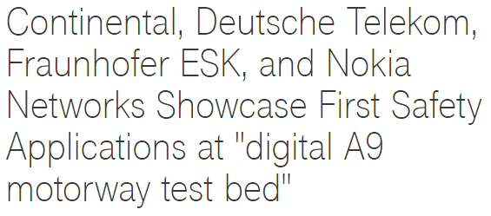
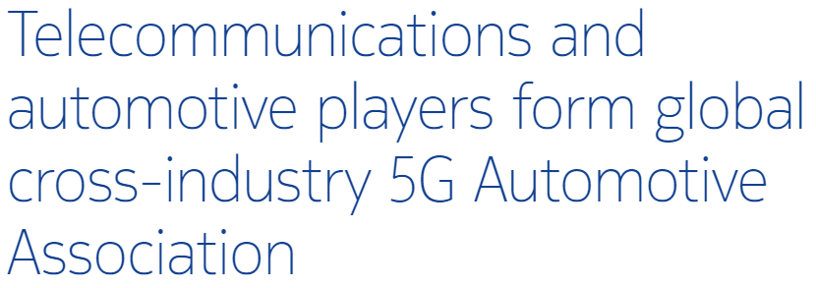
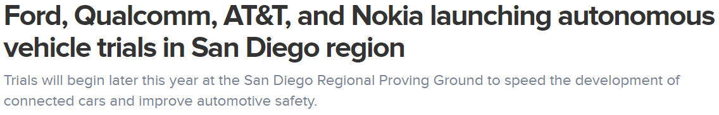
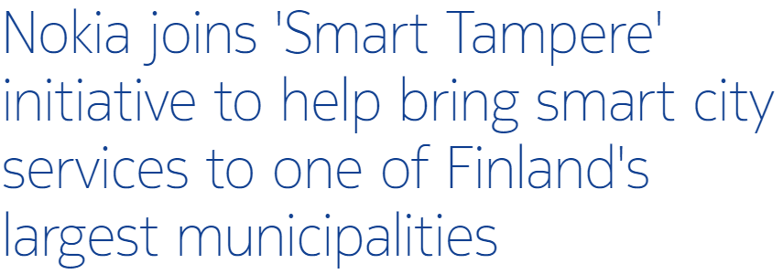
Leveraging Nokia’s global experience and Ottawa presence
As part of the ecosystem to enable the AV community in Ottawa

Slide 8
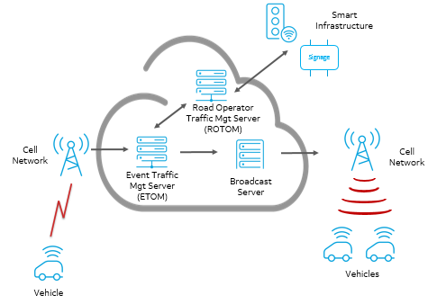
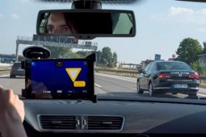
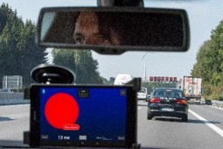
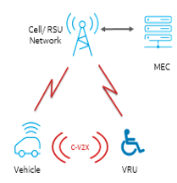
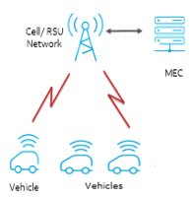
Lead Use Cases
Event notification: vehicles, drivers, emergency services
Augmented driver assistance: e.g. electronic brake light
Vulnerable road users (e.g. motorized wheelchair)
Eco approach to optimizing journey: e.g. optimal speed in urban environments through multiple signaled intersections

