Slide 1
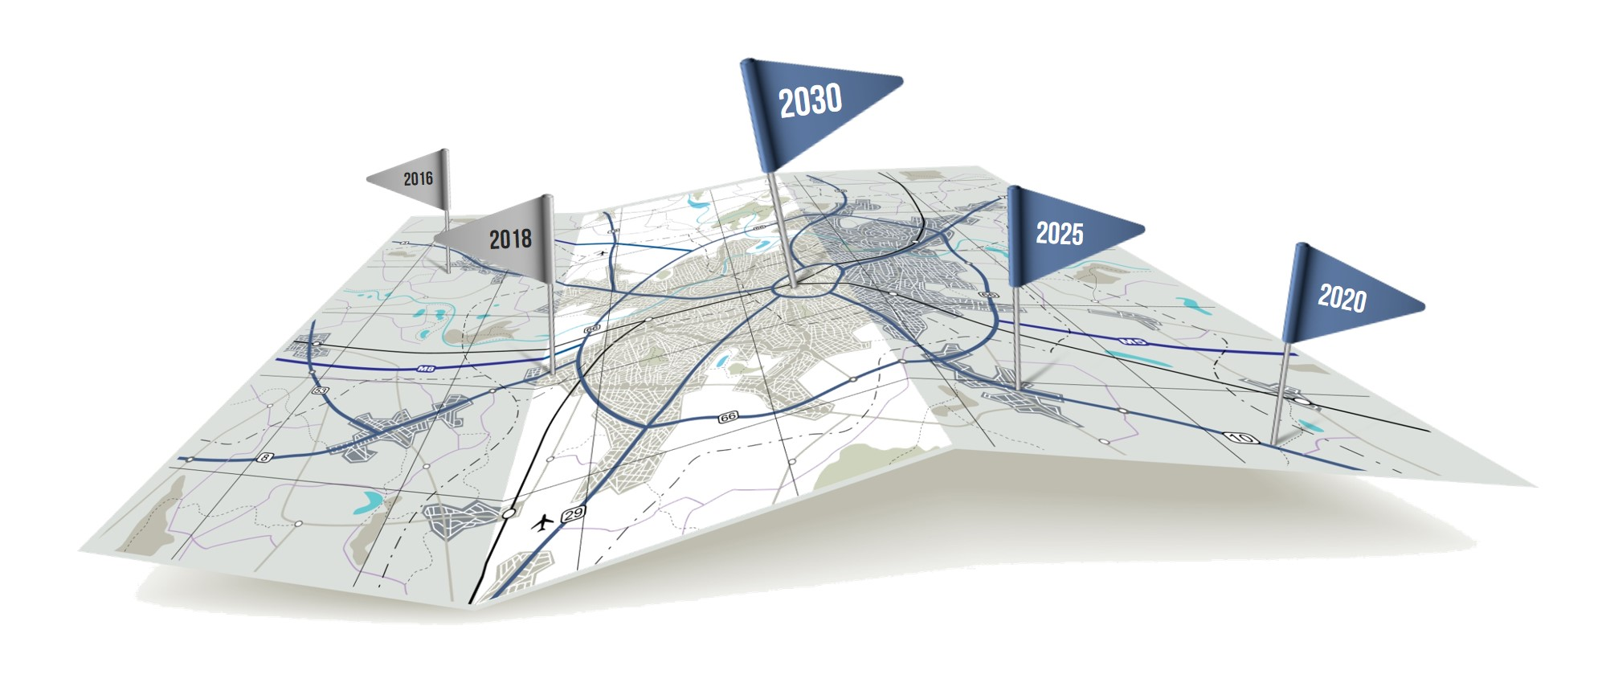

ALGONQUIN COLLEGE
Moving Towards a Future
of Innovation and Entrepreneurship

Slide 2
Cristina Holguin-Pando, M.Sc.
Director, Partnerships Applied Research, Innovation and Entrepreneurship

Slide 3
APPLIED SCIENCES AND ENGINEERING
MISSION
To support non-routine engineering works aimed at improving partner products, materials, & processes.
VALUES
CARING
We have a sincere and compassionate interest in the well-being of the individual.
LEARNING
We believe in the pursuit of knowledge, personal growth and development.
INTEGRITY
We believe in trust, honesty and fairness in all relationships and transactions.
RESPECT
We value the dignity and uniqueness of the individual. We value the equity and diversity in our community.

Slide 4
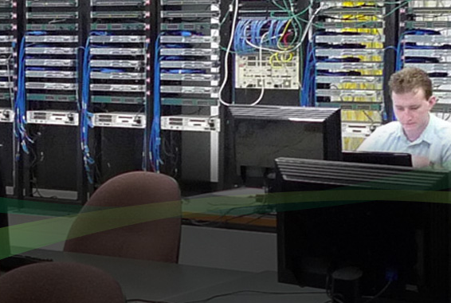
Academic Programs Aligned with Market Trends
Support students to:
  Gain an education credentials
  Applied training
  Get work experience
  Foster curiosity
  Complete research

Slide 5
Applied Research
Over 15 years of applied research in the classroom
Eligibility for NSERC, SSHRC, CFI, NRC, OCE research funding, among others
  $23.5M of research funds 2010-2017
Industry driven projects with IP policy in favor of industry led commercialization
  6000 students involved in 2000 projects with about 2000 companies. 1000 commercial prototypes developed
5 Research Centres with core Digital Technology capabilities to include: Design and U/X, Health and Wellness, Construction Research, Applied Sciences and Engineering and Data Analytics

Slide 6
Skills Relevant to Autonomous Vehicles
Electrical and Mechanical Engineering Technology;
Electro-Mechanical Engineering Technician – Robotics;
  Electrical power and controls;
  Mechanical design and prototyping;
  Robotic systems programming;
  Reverse-engineering;
Wireless Systems
  Smart Cities WiMAX ‘Mobile’ / LTE;
Data Analytics
  Data management and analysis;
  Programming and testing of proprietary algorithms.

Slide 7
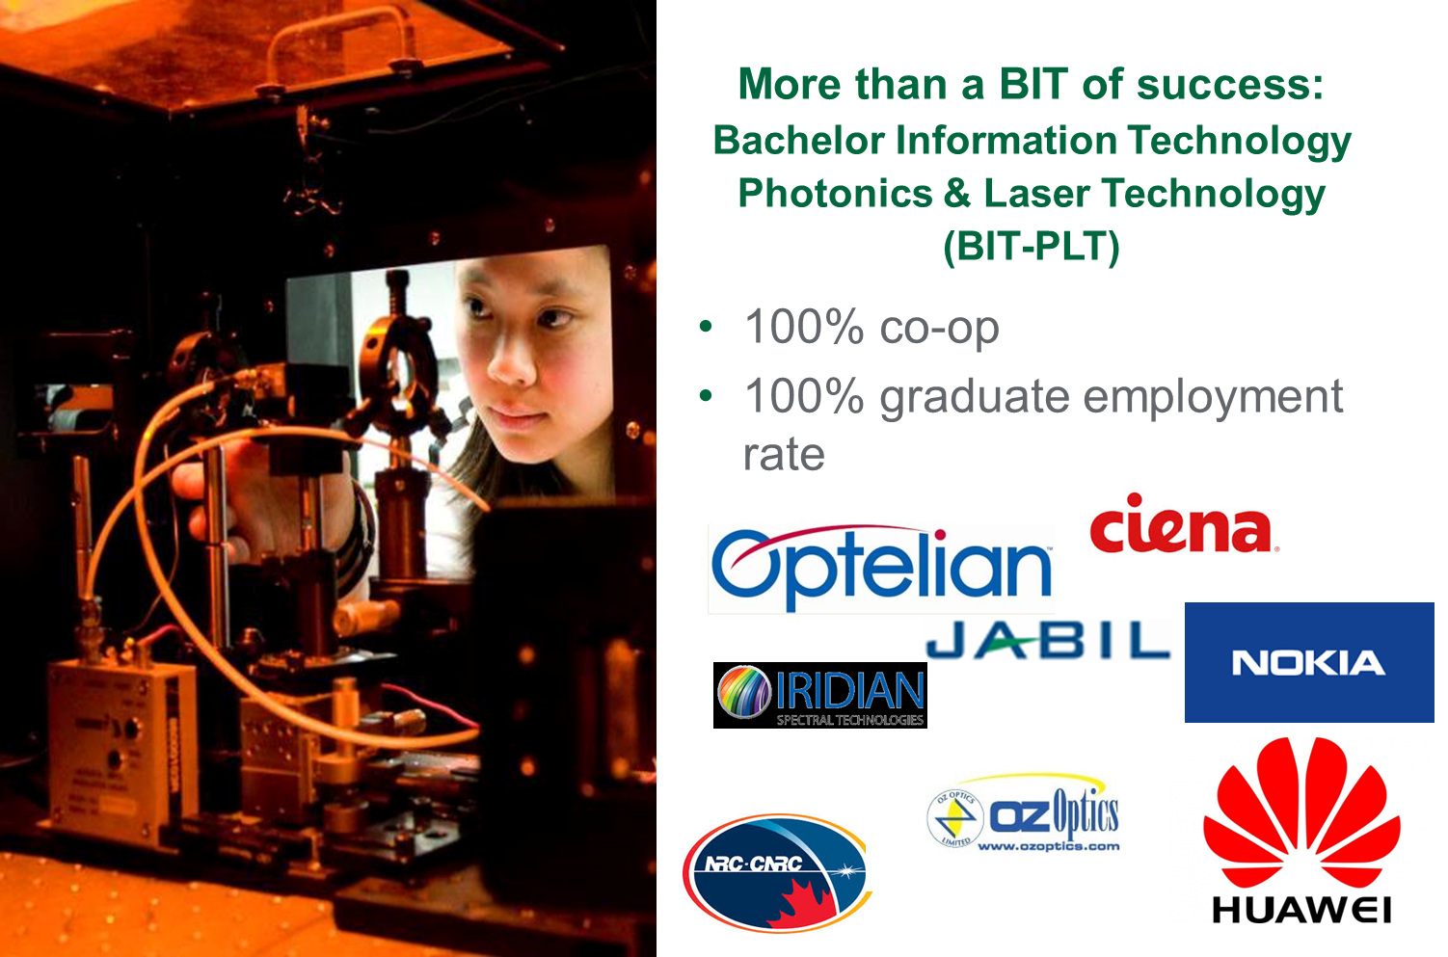

Slide 8
Thank you!

