Slide 1
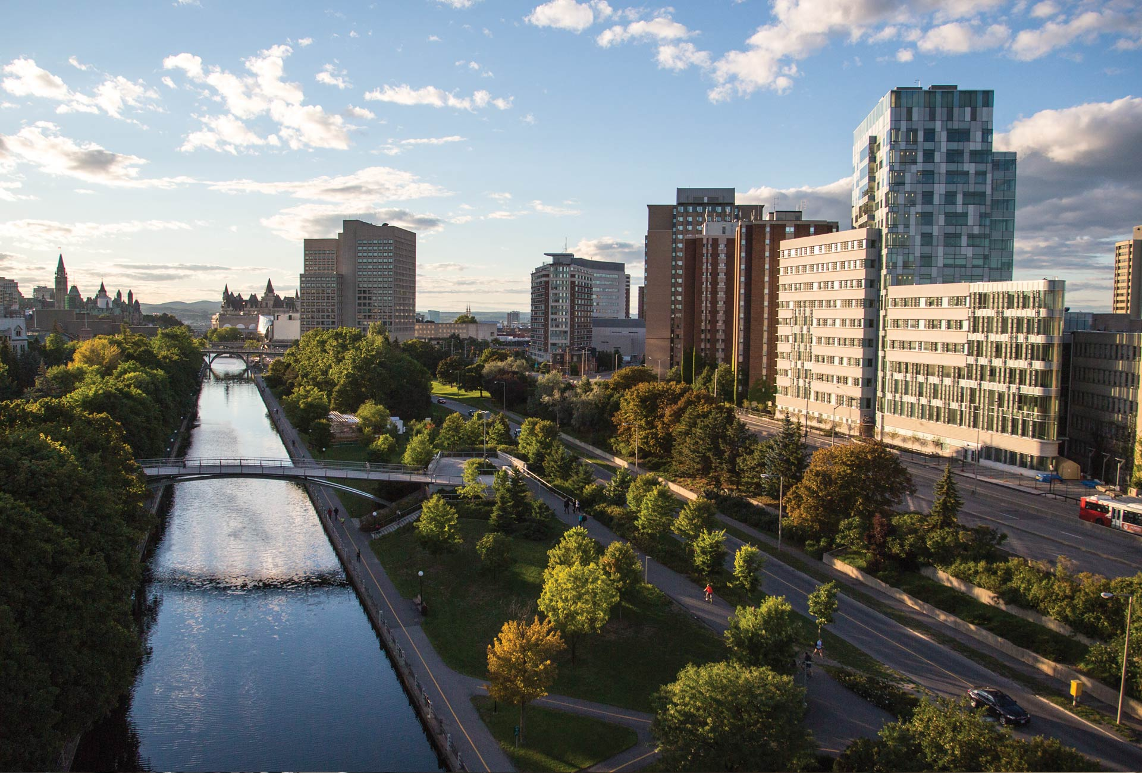

Autonomous & Connected Vehicles
Faculty of Engineering, University of Ottawa
uOttawa.ca
Carlisle Adams

Slide 2
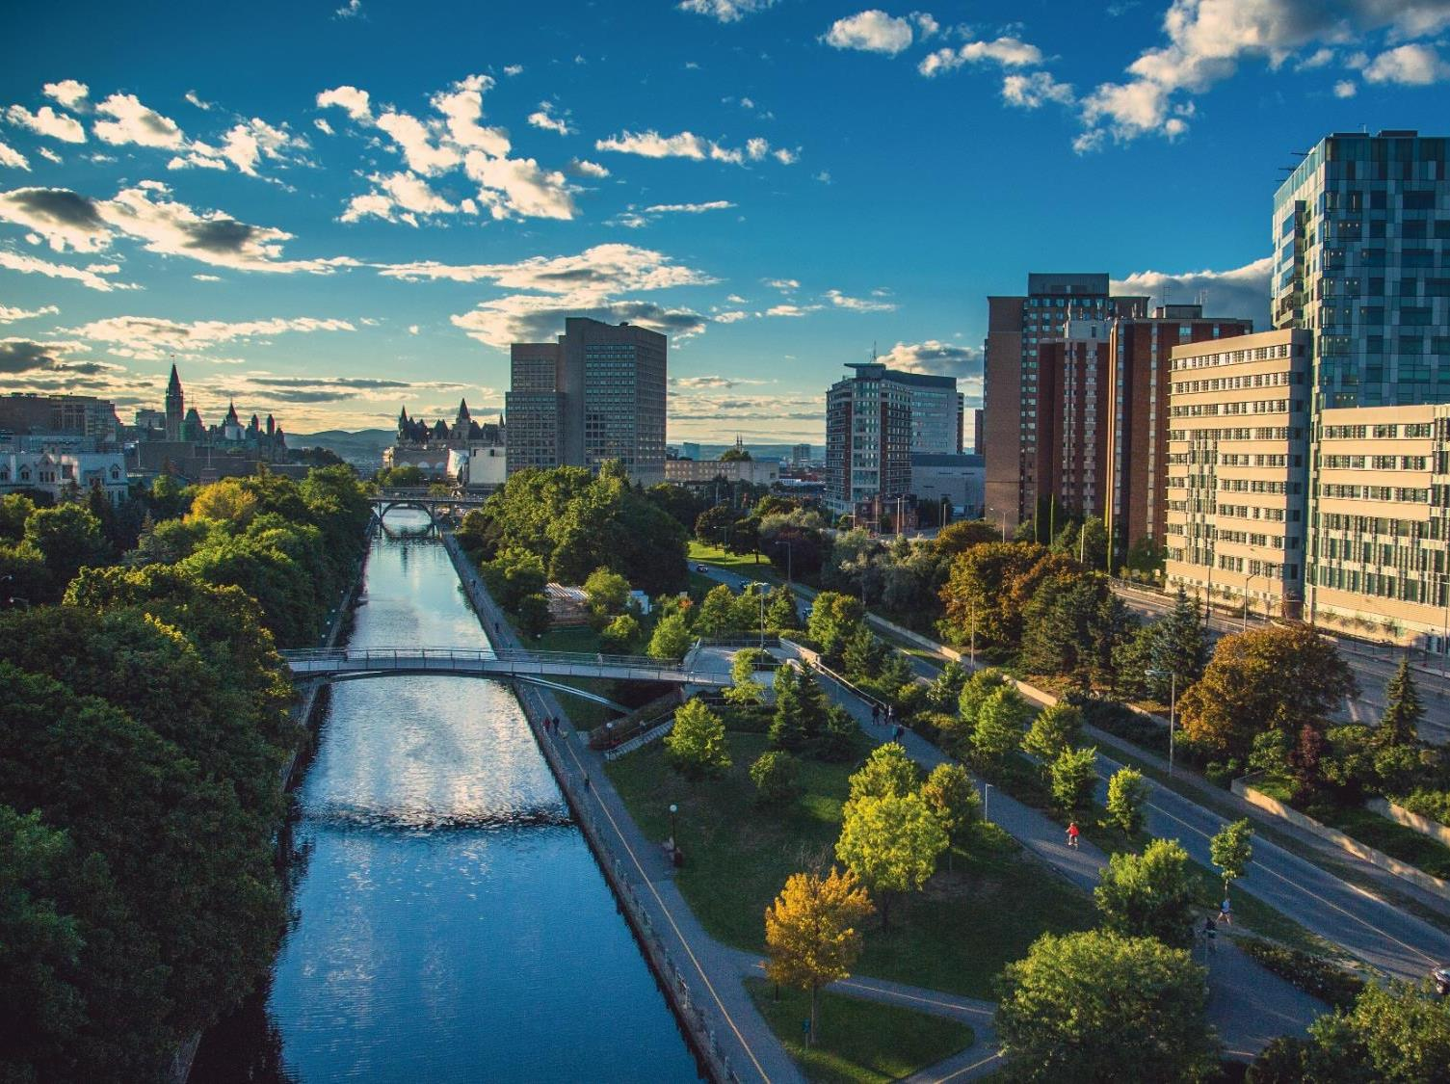

Economic impact
$6.8-$7.4 billion per year
Contributes over $1.5 billion annually to Canada’s GDP
Largest bilingual university in the world
French-English
Generate and support over 29,500 jobs across Canada
Among Canada’s Top 10 research universities
Budget of
1.4 Billion
Notes:
*Source: Impact of the University of Ottawa by The Conference Board of Canada, January 2016

Slide 3

The Faculty by the numbers
3
Undergraduate (UG) enrolment (fall 2017): Close to 4,500
UG degrees awarded (2016): 401
Graduate (G) enrolment (fall 2017): Over 1,500
G degrees awarded (2016): 608
Regular full-time professors: 128
Regular support personnel: 90
Buildings and facilities (44% research labs): 21,540 m²

Slide 4
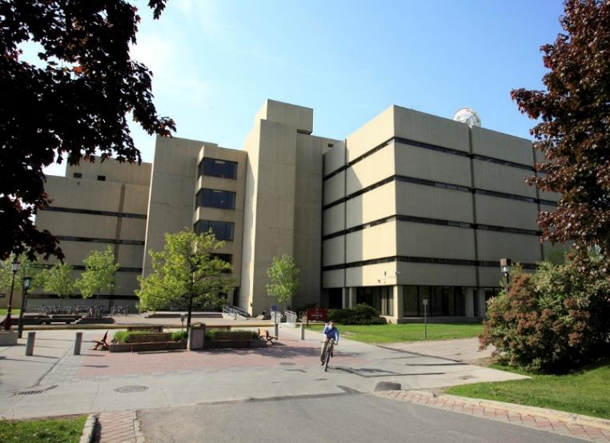
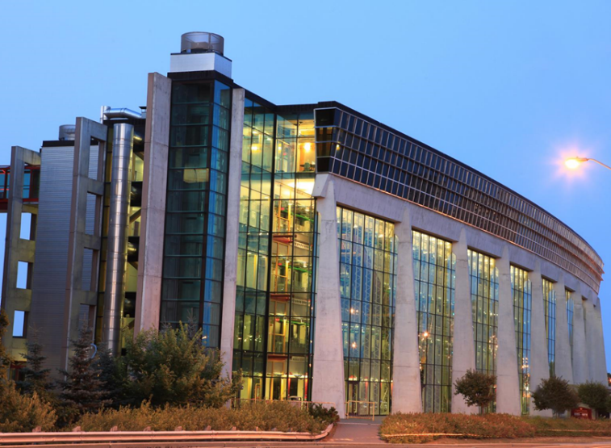
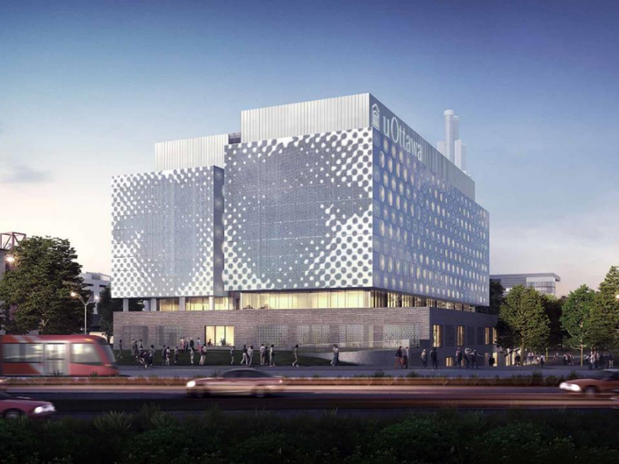
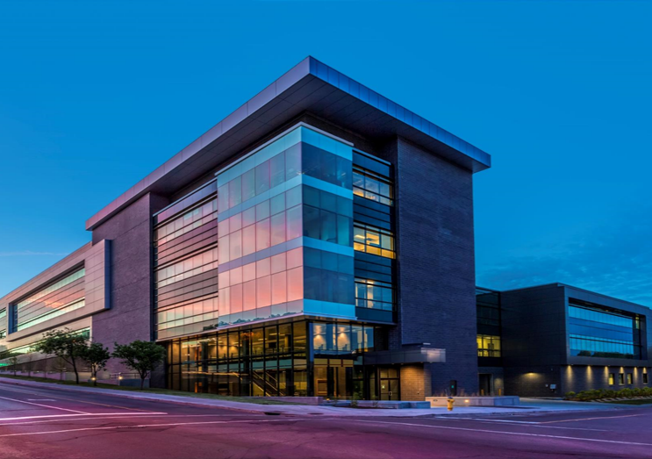
Chemical & Biological Engineering
Civil Engineering
Mechanical Engineering
Electrical Engineering and Computer Science
Colonel By
SITE
Centre for Advanced Materials Research (CAMaR)
Photonics
Centre for Entrepreneurship and Engineering Design
Civil Engineering
Mechanical Engineering
Advanced Research Complex
New STEM Complex

Slide 5
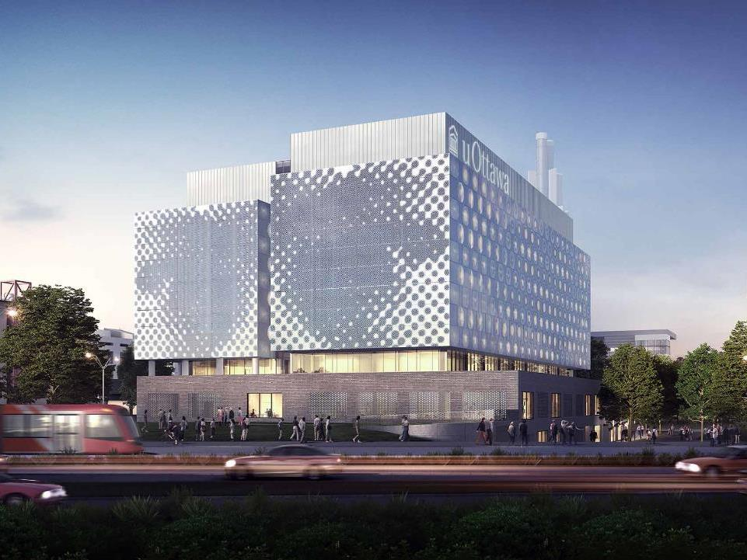

Faculty of Engineering
Strategic Research Themes
Enabling Technologies for Health Care and Augmented Life
Technology for Digital Transformation of Society
Sustainable and Resilient Infrastructure
Emerging Materials and Processes: Design and Development
Photonics for Devices,
Networks and Energy
genie.uOttawa.ca |engineering.uOttawa.ca
Notes:
To open in 2018
Eastern Ontario’s largest “discover district” to convert cutting-edge research into promising new technologies
Increasing space for research, innovation, experiential learning and entrepreneurship

Slide 6





Strategic Research Themes: AV Spotlight
• Nanomaterials
• Composite Materials
• Additive Manufacturing
• Sustainable Materials
• Biomedical Materials
• Electronic Materials
• Solar energy
• Biophotonics
• Microwave photonics
• Plasmonics
• Quantum photonics
• Fibre optics
• Optoelectronics
• Optical materials
• Biofeedback and well-being
• Biomedical engineering
• Biomechanics
• Health informatics
• Business processes and performance management
for healthcare
• Biomedical signal processing
• Biosensors, instrumentation and devices
• Data mining and public health
• Artificial Intelligence, Robotics and
Autonomous Systems
• Communications Networks and Services
• Internet of Things/Machine-to-Machine Systems
• Advanced Data Management and Analytics
• Cybersecurity
• Human Interaction with Digital Media
• Software Engineering
• Text Mining and Machine Learning
• Natural and human-induced hazard mitigation
• Physical and cyber infrastructure protection and security
• Smart (instrumented) infrastructure
• Infrastructure rehabilitation
• Building information modelling and visualization
• Life cycle analysis and lean construction optimization
• Climate change adaptation
• Water security
• Advanced and/or sustainable construction materials
• Smart cities
• Renewable energy
• Efficient vehicles
Notes:
To open in 2018
Eastern Ontario’s largest “discover district” to convert cutting-edge research into promising new technologies
Increasing space for research, innovation, experiential learning and entrepreneurship

Slide 7
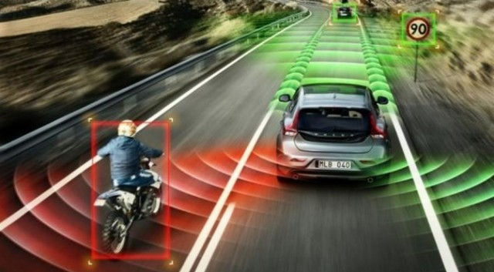
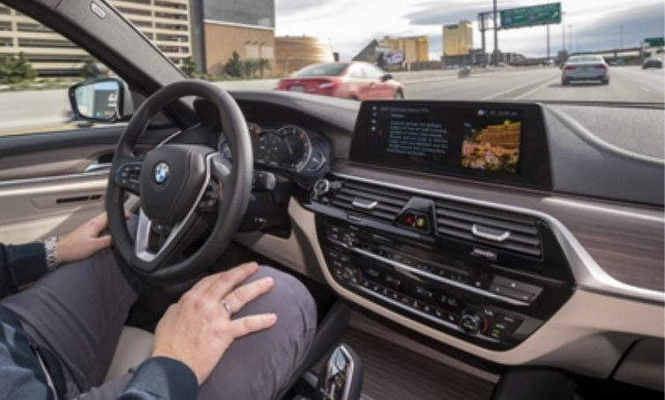
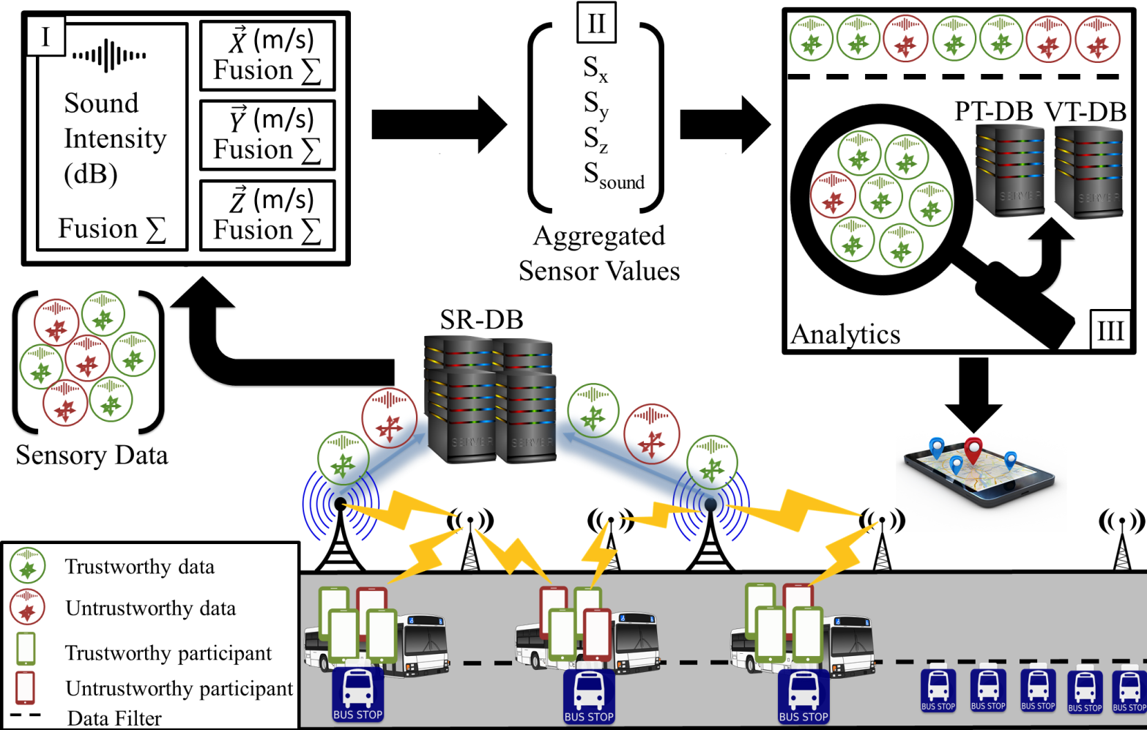
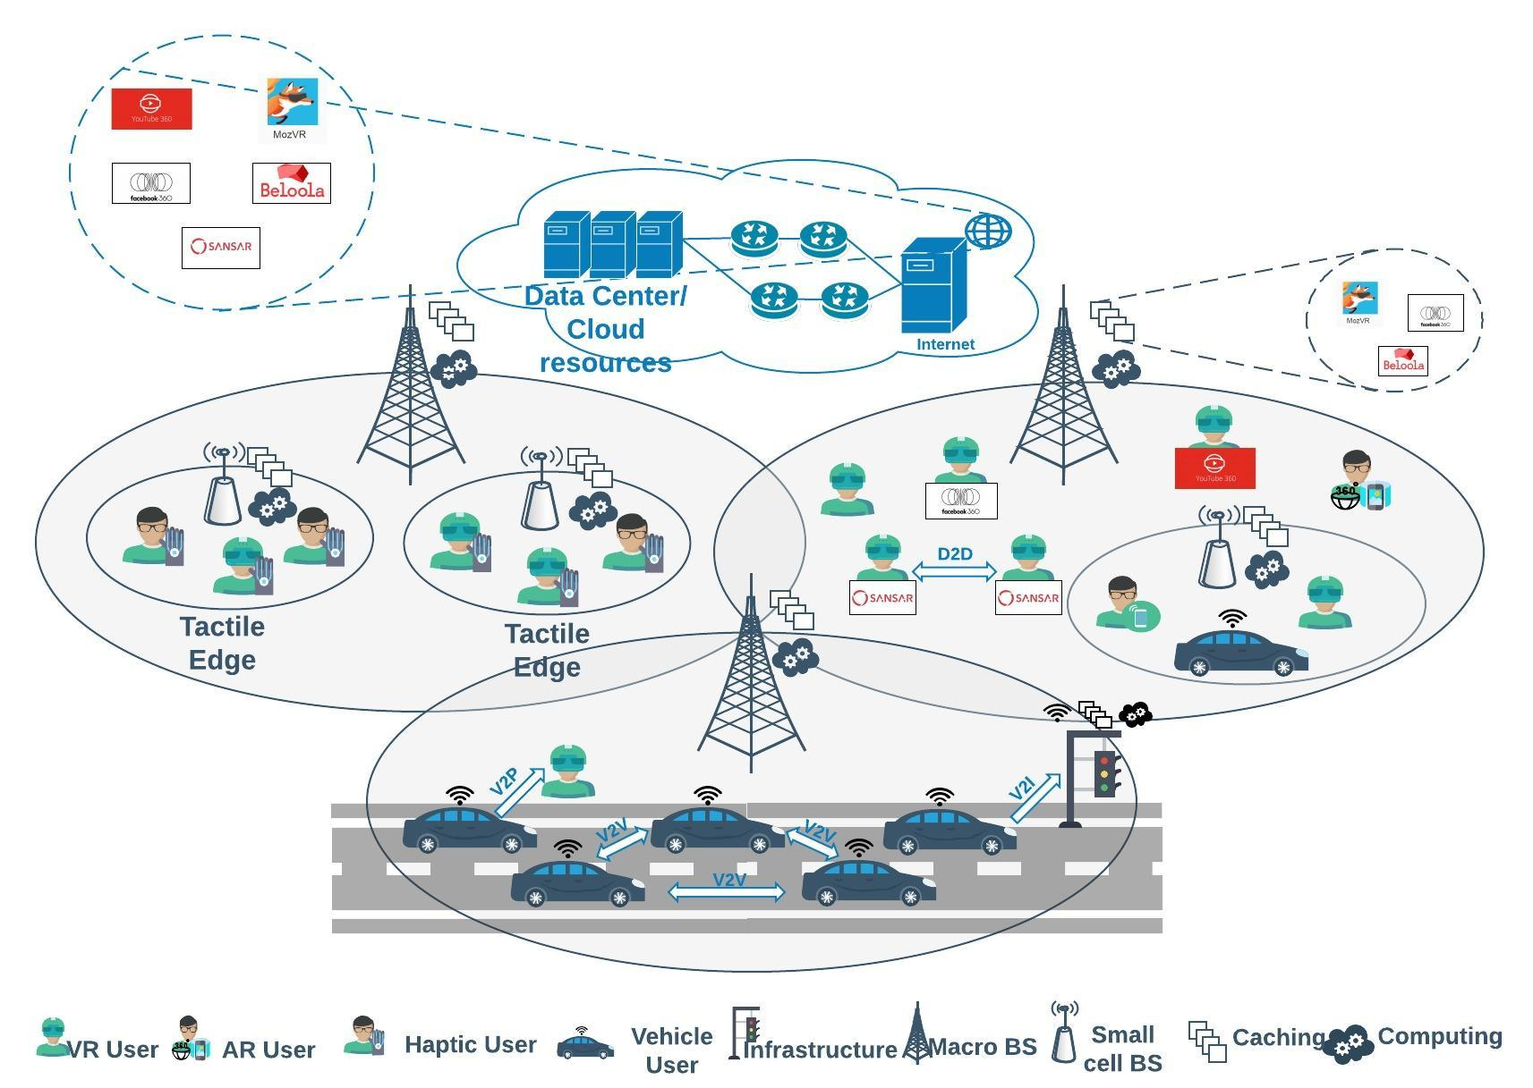
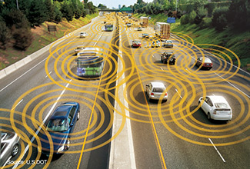
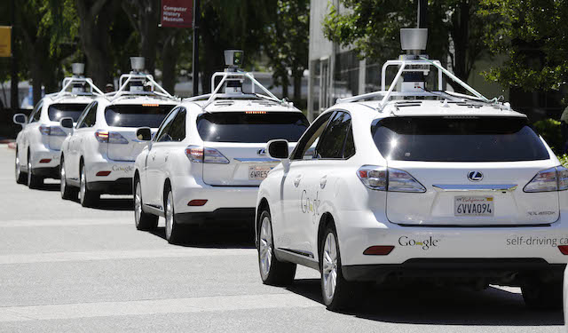
Autonomous Vehicles (18+ Professors; 120+ Students)
© 2018 Dr. Erol-Kantarci

Slide 8

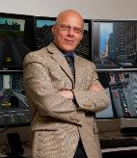
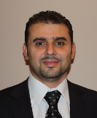
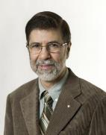
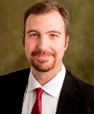

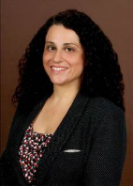

Strategic Research Themes: AV Spotlight
Communications
Azzedine Boukerche
1. Next Generation Intelligent Vehicular Networks and Applications (DIVA NSERC Strategic Network)
2. Advanced Network Systems for Intelligent Transportation (NSERC CREATE TRANSIT)
Abdulmotaleb (Abed) El Saddik
Multimedia communications, Distributed & collaborative virtual environments
Hussein Mouftah
Intelligent Transportation Systems protocols and communication algorithms
Burak Kantarci
Wireless Networks, IoT, Mobile Computing, Cloud and Fog Systems, Machine and deep learning for mobile networks
Melike Erol Kantarci
Low-latency wireless networks, AI and machine learning to enable next generation networks AV requires
Notes:
To open in 2018
Eastern Ontario’s largest “discover district” to convert cutting-edge research into promising new technologies
Increasing space for research, innovation, experiential learning and entrepreneurship

Slide 9
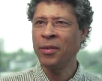
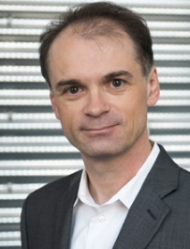
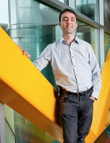
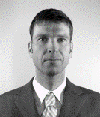

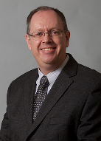
Strategic Research Themes: AV Spotlight
Cybersecurity
Carlisle Adams
Cryptography, computer & network security, privacy technologies
Guy-Vincent Jourdan
Distributed systems modeling and analysis, software engineering, Software security
Machine Vision
Robert Laganière
Content-based video analysis, Object recognition, 3D reconstruction
Jochen Lang
Computer vision, Computer graphics, Computational photography
Wonsook Lee
Computer Vision
Pierre Payeur
Machine vision and image processing, 3D sensing and modelling, robot navigation
Notes:
To open in 2018
Eastern Ontario’s largest “discover district” to convert cutting-edge research into promising new technologies
Increasing space for research, innovation, experiential learning and entrepreneurship

Slide 10
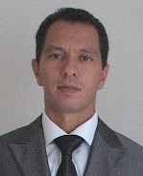
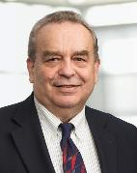
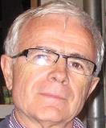
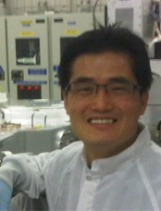
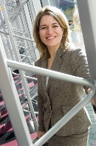
Strategic Research Themes: AV Spotlight
Robotics
Wail Gueaieb
Robotics and autonomous systems
Emil Petriu
Robotics, Intelligent sensor systems
Dan Neculescu
Robotics, AV navigation and control, Model predictive control for collision avoidance
Materials and Devices
Jeongwon Park
Nanotechnology & devices
Karin Hinzer
Photovoltaic Devices and Systems, Smart Autonomous Grid Edge
Notes:
To open in 2018
Eastern Ontario’s largest “discover district” to convert cutting-edge research into promising new technologies
Increasing space for research, innovation, experiential learning and entrepreneurship

Slide 11
Strategic Research Themes: AV Spotlight
Tier 1 Canada Research Chair in Verification and Validation of Software Systems
Tier 2 Canada Research Chair in Ethical Engineering of Robotics and AI
Notes:
To open in 2018
Eastern Ontario’s largest “discover district” to convert cutting-edge research into promising new technologies
Increasing space for research, innovation, experiential learning and entrepreneurship

Slide 12
Autonomous Vehicles: Cybersecurity
Current status
  Increasing automation (from driver assistance to fully autonomous)
  Increasing software size & complexity
  Increasingly diverse and complex supply chains
  No/few security requirements or certifications

Slide 13
Autonomous Vehicles: Cybersecurity
Threat model
  Physical attacks, remote attacks (short-range, long-range)
  Goal of the attacker
    Control a specific vehicle
    Control a fleet of vehicles
    Control all vehicles of a particular model

Slide 14
Autonomous Vehicles: Cybersecurity
Strategy: Defence in Depth
  From secure boot to secure upgrades
  Confidentiality, integrity, authenticity, availability, authorization, access, non-repudiation, audit
  Formal methods, penetration testing, security proofs, extensive test bed environments, verification, certification
Directions
  Innovative key management
  Verifiable provenance in supply chains
  Anomalous behaviour detection

Slide 15
Autonomous Vehicles
New Challenges,
New Opportunities…
Exciting times ahead!

