Slide 1

Moving Towards a Smart City
Traffic Services Initiatives
Philippe Landry, P.Eng.
Director Traffic Services
Transportation Services Department
Ottawa AV Innovation 201
May 22 2018

Slide 2
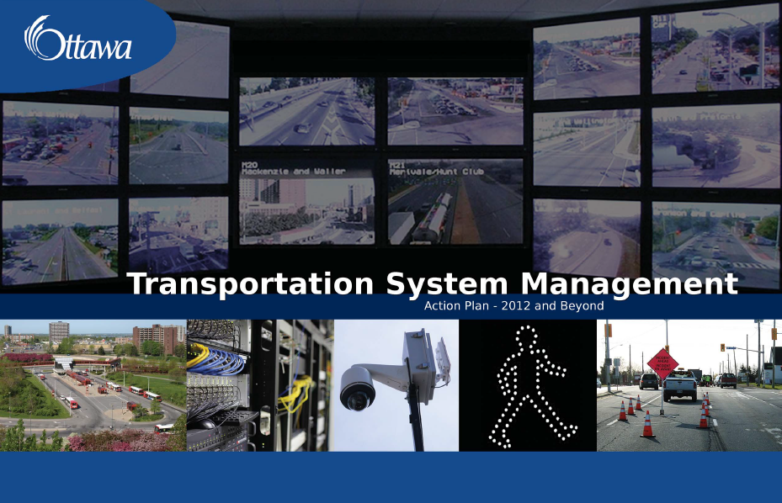
TSM Strategy

Slide 3
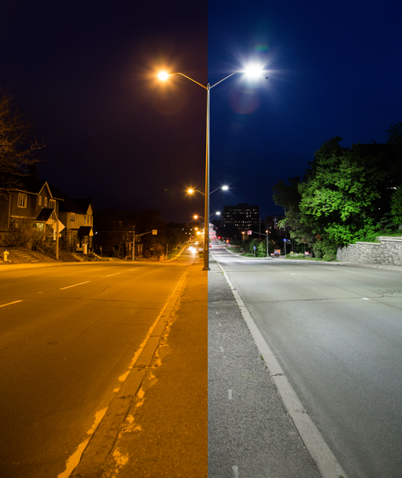
LED Streetlight Conversion Project

Slide 4
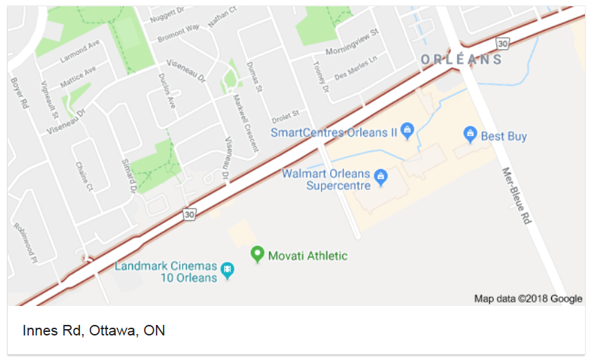
Adaptive Traffic Control
Innes Road Project

Slide 5
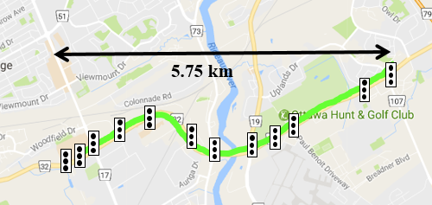
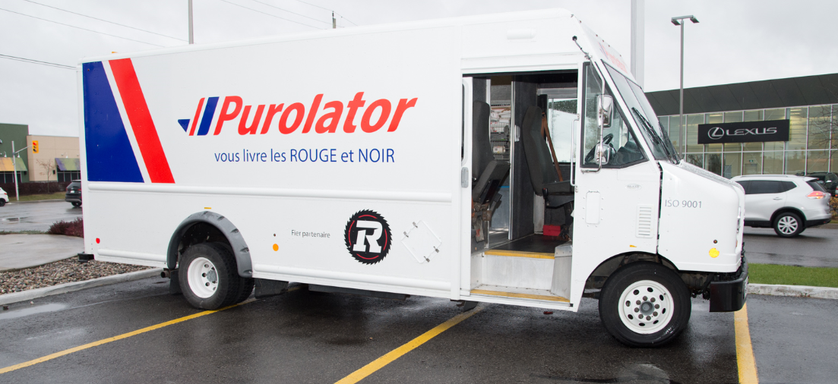
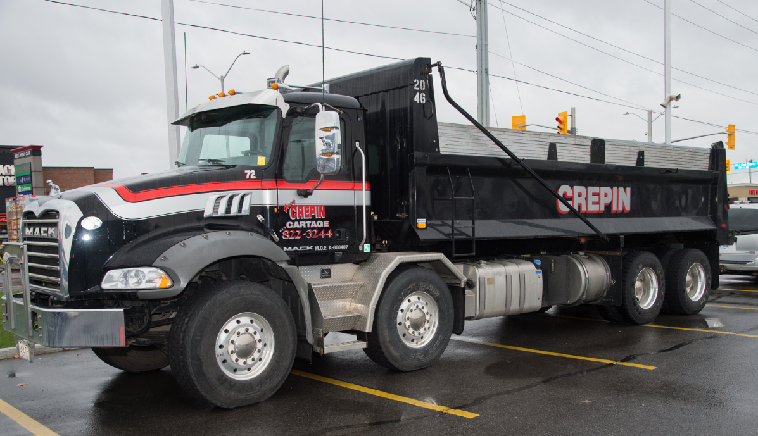
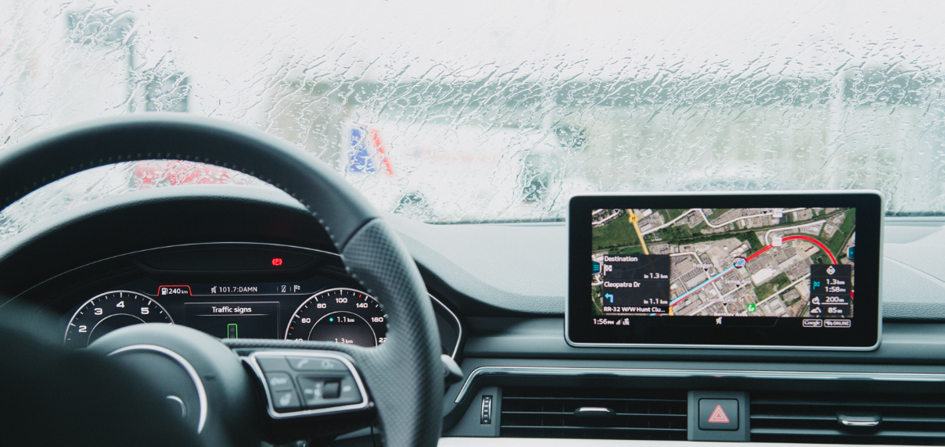
Eco-Drive I2V Connected Vehicle Project
Ottawa - Audi Demonstration

Slide 6
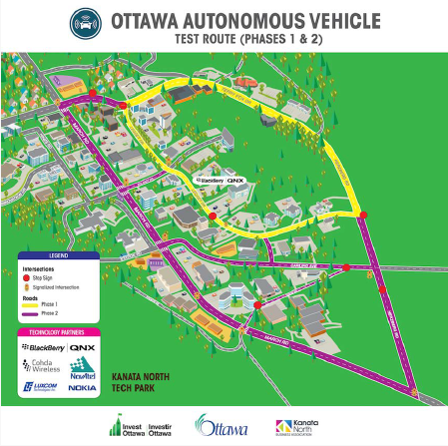
Dedicated Short Range Communication (DSRC) with BlackBerry QNX

Slide 7
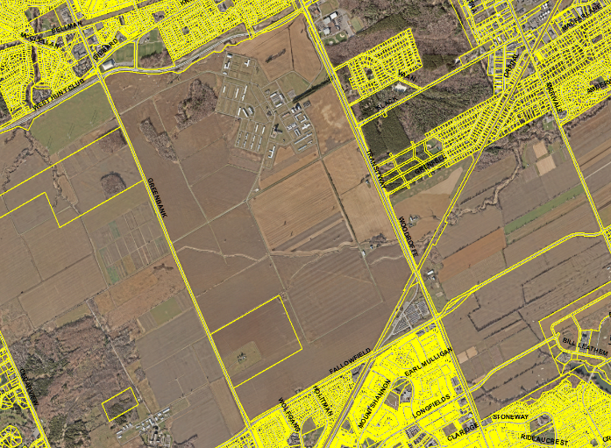
NCC Greenbelt Research Farm
Unique urban farm.
Gated 1,860-acre facility with 1,560 acres of farmland.
16-kilometre road network.
3 Traffic Signals, LED lighting, stop signs will be installed

Slide 8
The Future…
Leverage City’s Existing Traffic System Infrastructure to
Foster partnerships with Government and Industry
Pilot I2V projects with industry and academia
Pilot technologies to enhance cycling and pedestrian safety

