Slide 1

y
Engineering Development Tools for Engineers
Dave Stubbs
stubbs@neutroncontrols.com
May 2018

Slide 2
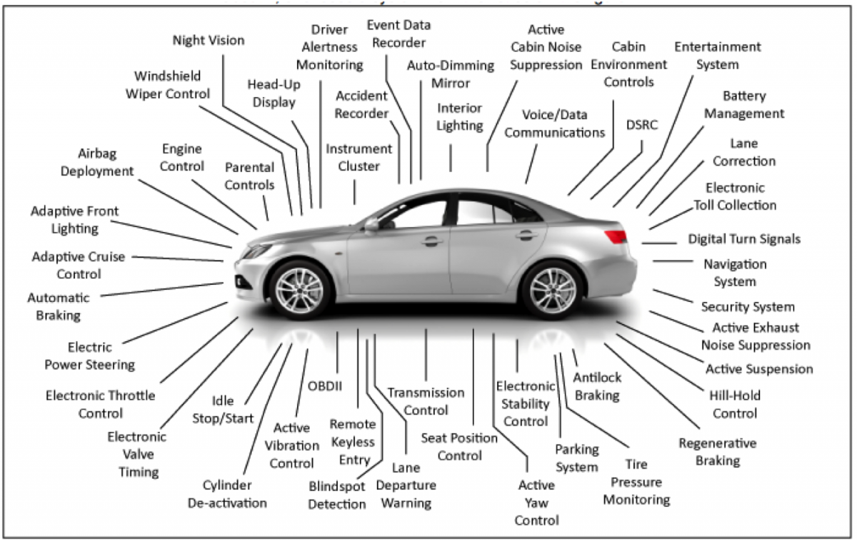

The System Development Dilemma…
How do you get there from here

Slide 3
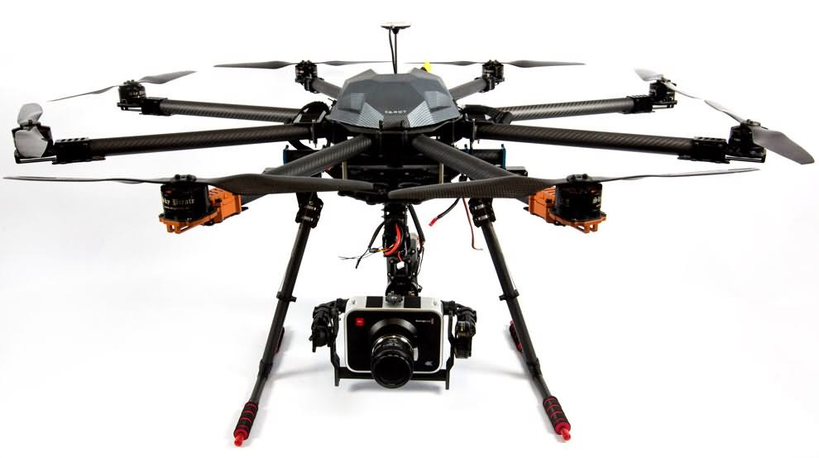


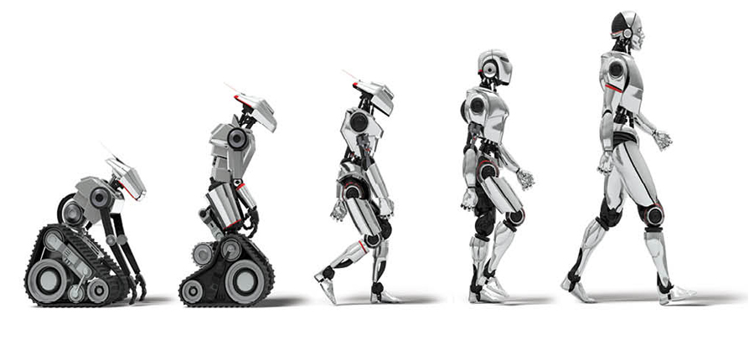
Target Applications for
AURIX MutiCore Controllers
Drones and Motor Control
Autonomous, EV, ADAS
Safe Industrial Controls
Advanced Robotics

Slide 4

ONZEROS™
SYSTEM LEVEL OPERATIONAL SOFTWARE

Slide 5
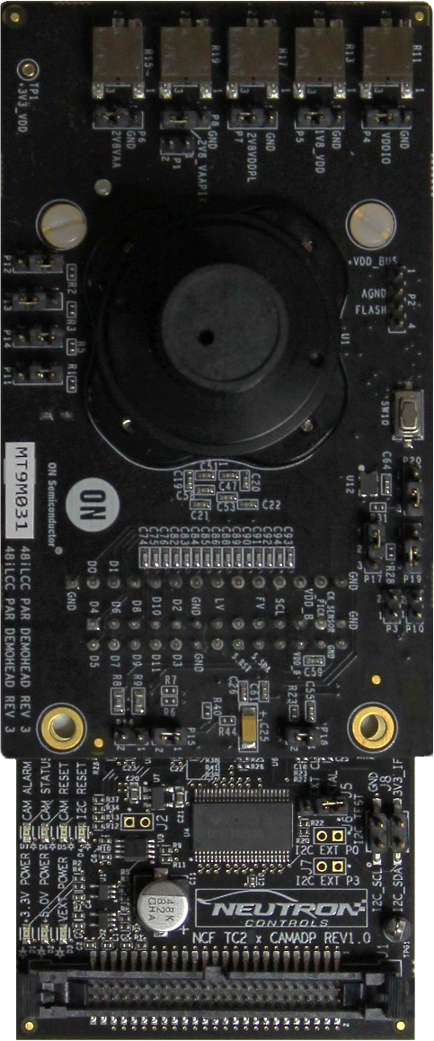
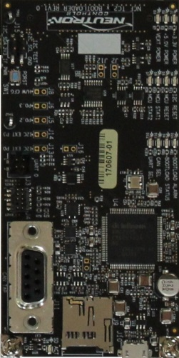
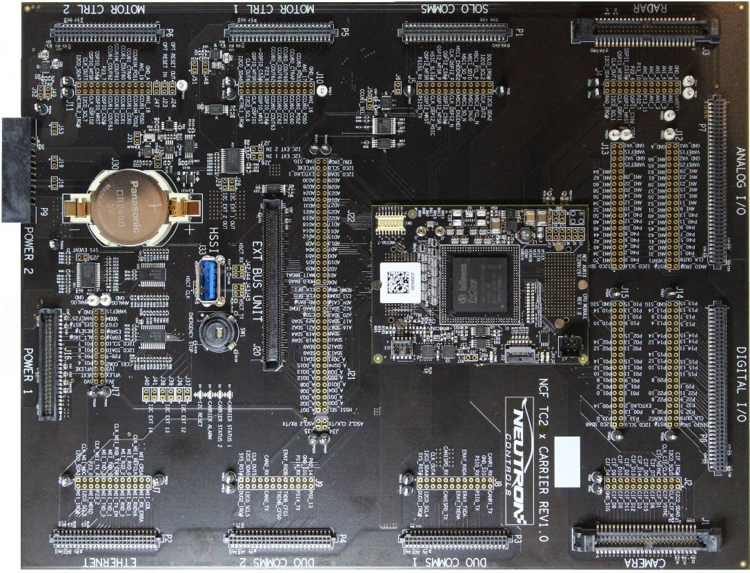
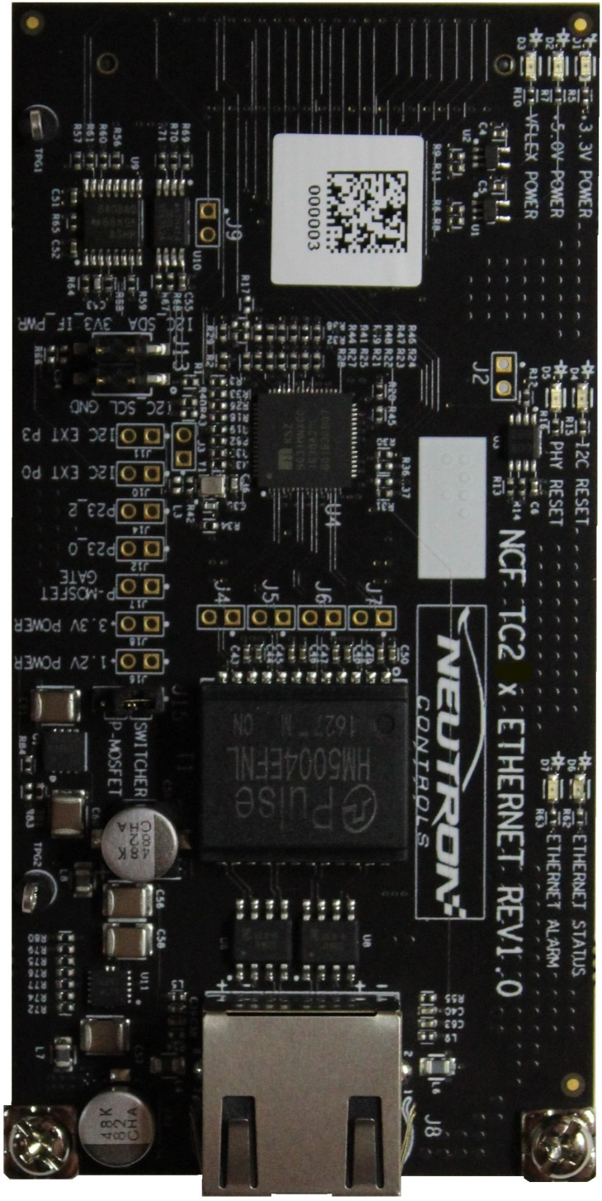
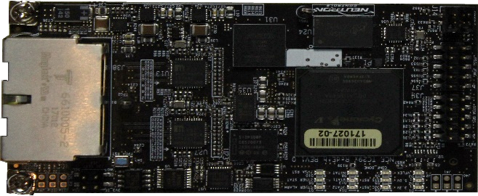
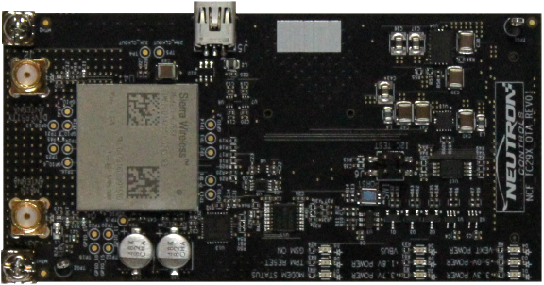

CAMERA
ONZEROS SOFTWARE
SECURE BOOTLOADER
CARRIER DEVELOPMENT PLATFORM
BOOTLOADER
CAN / USB
ONZEROS SOFTWARE
ETHERNET INTERFACE
10/100 ETHERNET
2 Port
Gig Ethernet
ONZEROS SOFTWARE
REDUNDANT ETHERNET
NETWORK
4G OTA
Cellular
ONZEROS SOFTWARE
FUNCTIONAL SAFETY
SYSTEM VALIDATION
DC MOTOR CONTROL

Slide 6
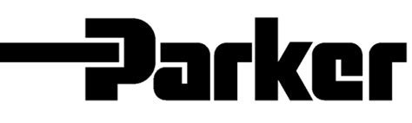







End User Reaction

Slide 7
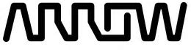








Global Reach

Slide 8


