Slide 1
The Ottawa AV Ecosystem
The First End-to-End Integrated AV Test
Environment of its Kind in North America

Slide 2
Ottawa is a Tech Hub
For three decades, Ottawa has been a global leader in telecommunications technology.
Today, Canada’s capital is one the hottest and most diverse tech hubs in North America.
756,000
1,324,000
1,822
77,000
69,000
Notes:
Ottawa region is home to more than 1800 ICT companies with expertise in networks, security, cloud mobile, analytics, machine learning and Software
Home to AV leader Blackberry QNX, OEMs such as Ford, and multinationals invested in AV verticals such as Nokia: attracting automotive/AV talent, R&D and business to the region
Government decision makers, regulators and policy for AV – Transportation Canada, NRC, CRC, DND, CANSOFCOM, RCMP
130 embassies/consulates: Window to global markets, attract international firms and investment
Vision and commitment from City, industry and the NCC: Land
Sectors: Communication technologies; defence and security; Software; life sciences (medtech); digital media and clean tech
Tech expertise: AI and machine learning; cybersecurity; Avs; smart cities and intelligent infrastructure

Slide 3
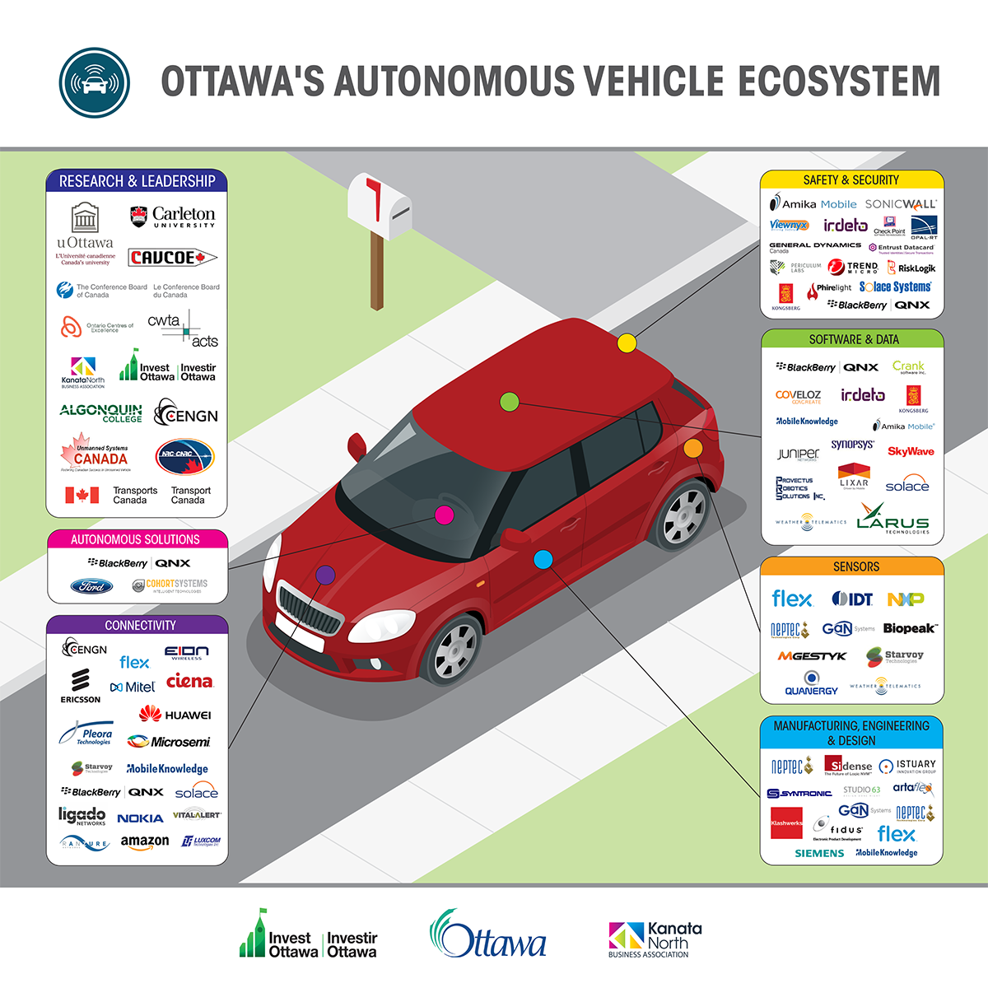
The Ottawa AV Ecosystem
Notes:
To help Ottawa (and Ontario more broadly) become a global leader in the development, testing, and commercialization of AV and related telecommunication technologies, driving new commercial opportunity, global market share and revenue for Ontario firms, and long-term economic benefit for Ontario citizens

Slide 4
Overview
Ottawa is an epicenter of AV innovation: 70+ SMEs, MNCs, PSIs, and other organizations contributing to AVs of the future
First municipality in Canada to connect an AV to live city infrastructure
Building on communications technologies and security strengths, our region is creating the first end-to-end integrated AV test environment of its kind in North America:
Evolution of Ottawa’s Public AV Test Track with 4G-LTE and 5G capabilities for on-road testing of licensed AVs in Kanata North Tech Park
Creation of a Private, Multi-sector/multi-use test bed to develop, test, interoperate and evolve technologies, systems, networks and apps in a real-world environment; and
Entrepreneurship programming

Slide 5
Key Differentiators: Foundation for Success
90% of Canada’s industrial telecom R&D occurs in Ottawa: wealth of connectivity capability (5G, 4G, LTE)
Ottawa is home to more than 180 security companies with expertise in network security, cloud mobile, biometrics and encryption
Home to AV leader Blackberry QNX, OEMs such as Ford, and multinationals invested in AV verticals such as Nokia: attracting automotive/AV talent, R&D and business to the region
Government decision makers, regulators and policy for AV – Transportation Canada, NRC, CRC, DND, CANSOFCOM, RCMP
130 embassies/consulates: Window to global markets, attract international firms and investment
Vision and commitment from City, industry and the NCC: Land

Slide 6
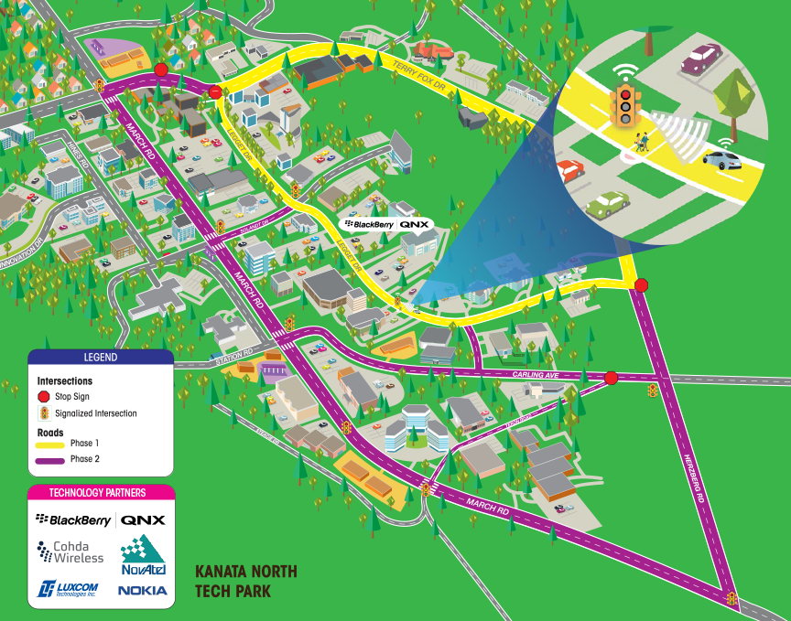
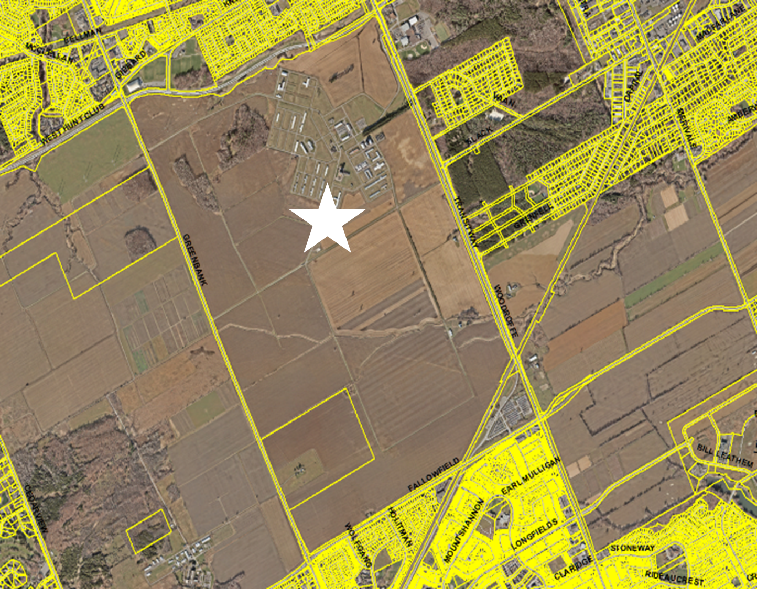
The First Integrated AV Test & Validation Environment of Its Kind in North America
The Public AV Test Track in Kanata North Tech Park
The private, gated AV test track at the NCC
Notes:
Public Test Track: Located in Canada’ largest technology park Phase 1: 9 Traffic Lights
1 Cross-walk
Dedicated Short Range Communications (DSRC)
Advanced GPS
Phase 2: Working with partners to add Cellular Wireless:
4G-LTE (Nokia)
5G (Ericsson)
New capability to test DSRC, 4G-LTE and 5G technologies including V2I, V2V, V2P and V2N
Areas of focus, opportunity and application include:
Smart City (that increase municipal efficiency, enhance impact on citizens)
Smart Agriculture
Rural and Remote Connectivity
Autonomous Vehicles (private road network – 16KM)
Public Safety (emergency services)
Environmental Monitoring (remote sensing, real-time data, etc.)
Secure/ Gated 1,860-acre facility with 1,560 acres of farmland with an additional 1,600 acres from the Canadian Food Inspection Agency
16 KM paved road network (in fair to good condition)
Partnering with Hydro Ottawa to install optical fiber onsite
Partnering with the City of Ottawa to install traffic lights, streetlights, cross-walks, etc.
The infrastructure will be connected to the City’s Traffic Management System

Slide 7
Addressing Key AV Challenges
Focused on enabling entrepreneurs, SMEs and multinationals to address five key AV/ CV challenges:
AV operations in inclement weather such as snow, ice, fog, and high winds
Development of systems that pinpoint the location of hidden objects (such as seeing around corners to spot moving people or objects)
Cybersecurity – AVs, smart infrastructure, and the Internet of Things
Interoperability, the ability of computer systems or software to exchange and make use of AV-generated data
Communication: Vehicle-to-Vehicle, Vehicle-to-Infrastructure (city), Vehicle-to-Network (DSRC/GPS/ 4G/ 5G)
Notes:
The challenges that we will be focused on take advantage of Ottawa unique technology expertise and climate
AV operations in inclement weather such as snow, ice, fog, and high winds
Development of systems that pinpoint the location of hidden objects (such as seeing around corners to spot moving people or objects)
Cybersecurity – AVs, smart infrastructure, and the Internet of Things
Interoperability, the ability of computer systems or software to exchange and make use of AV-generated data
Communication: Obvious areas of leadership for Ottawa in AV is communication and security with 90% of Canada’s industrial telecom R&D occurs in Ottawa: wealth of connectivity capability (5G, 4G, LTE) Vehicle-to-Vehicle, Vehicle-to-Infrastructure (city), Vehicle-to-Network (DSRC/GPS/ 4G/ 5G)

