Slide 1


Slide 2
The connected car is a key element of both the digital disruption in cars and the IoT revolution
The connected car leverages key IoT-enabling technologies such as sensors, analytics, big data, natural language processing, cloud computing, among others
Notes:
This will be the next stage of the connected car revolution as Autonomous Vehicles begin mass productions

Slide 3
Evolved Vehicle Environments(EVE) is a Canadian Owned Connected Car Software company – Located in Ottawa & Toronto
We have transformed the connected car experience and evolved our Digital LifeStyle on the go

Slide 4
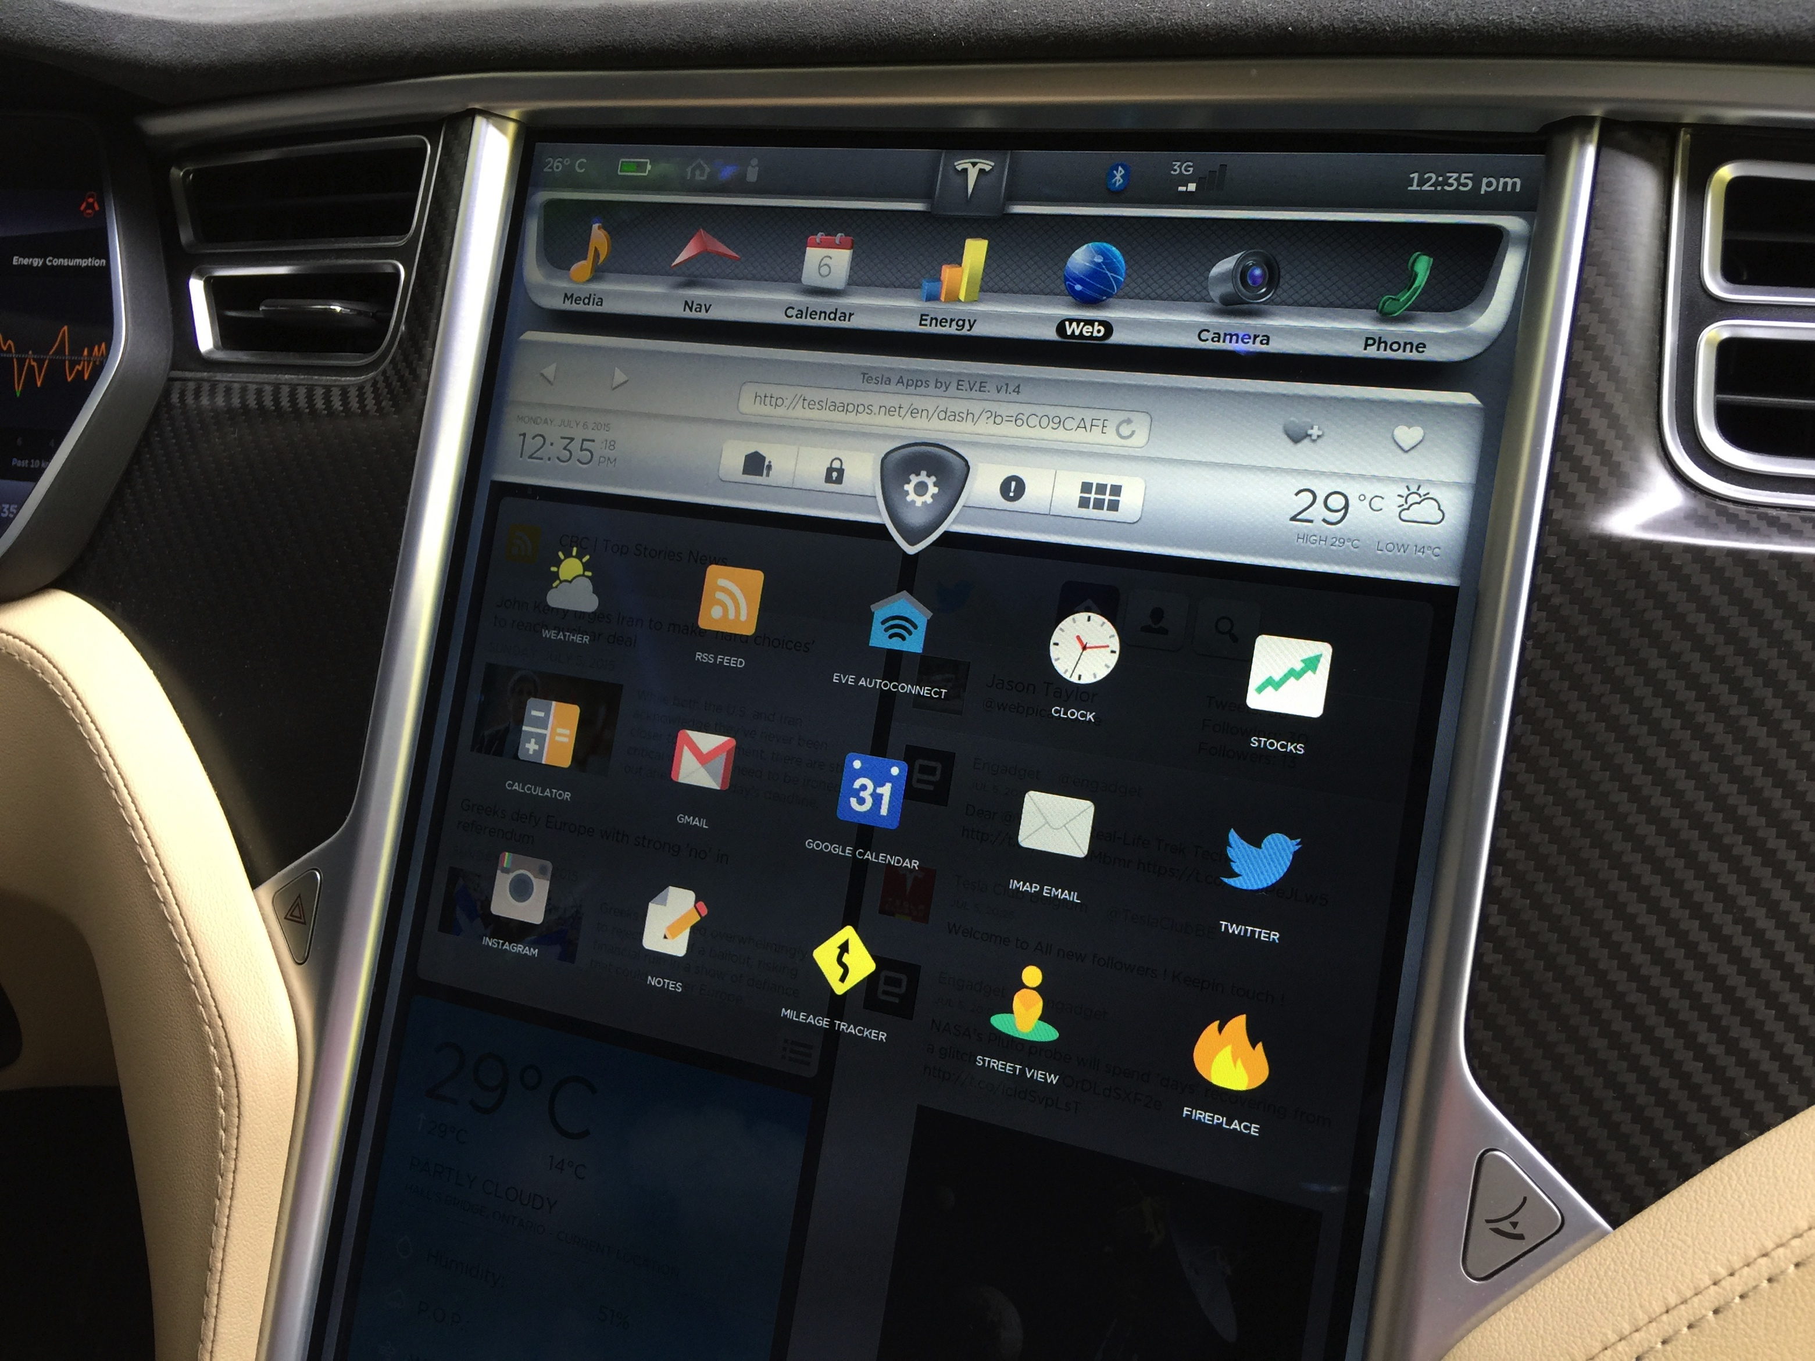
Notes:
Our solution is the leading in-market connected car solution that is fully functional, user customizable, and continually evolving. We originally Launched in Tesla and is available in 32 countries with 2 other OEM launches later this year.

Slide 5
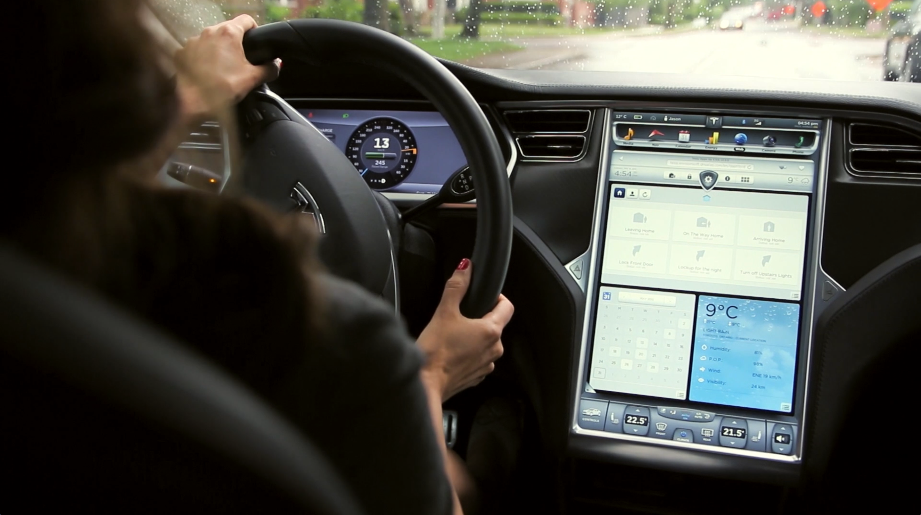
Notes:
You’re always on the go and we expect our digital lifestyle to follow. We have designed EVE from the ground up to be the next evolution of the connected car experience

Slide 6
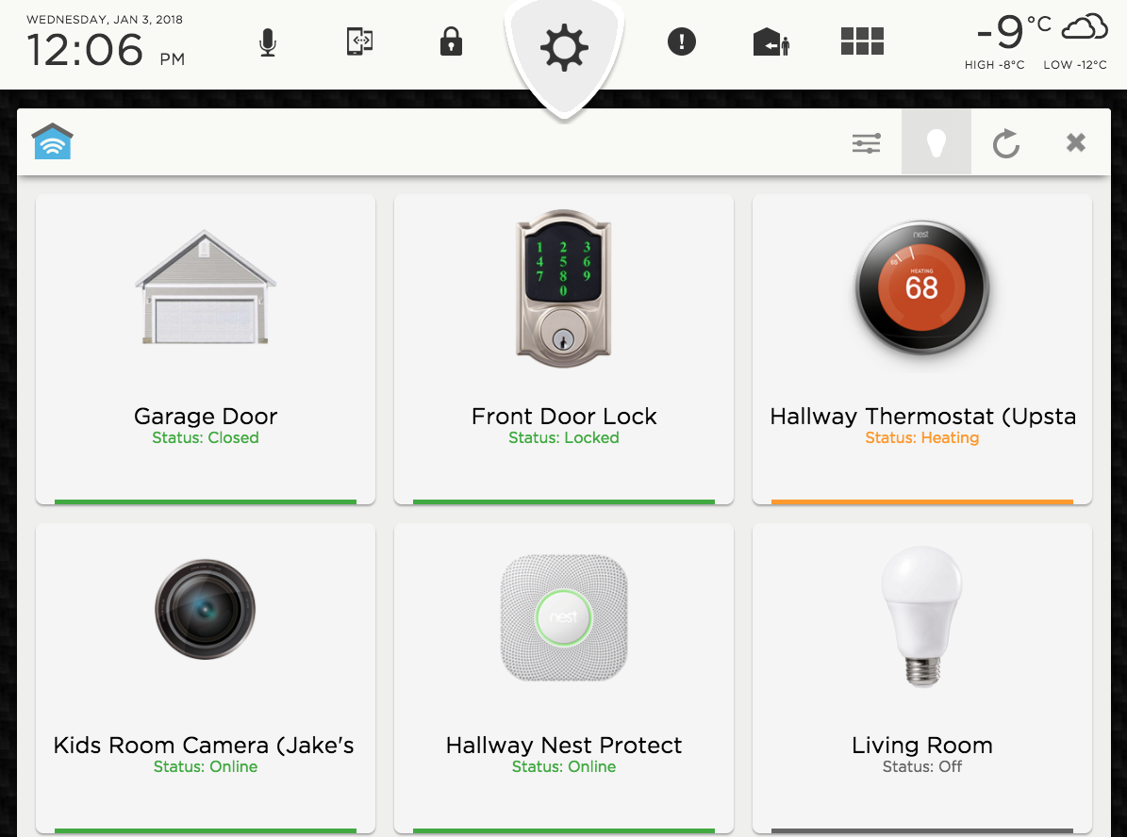
Notes:
One of our solutions is EVEConnect – launched in Jan 2018 at CES in Partnership with Clarion ( a global connected car platform), in addition, we went live with EVEConnect in Tesla. EVEConnect is the only solution that integrates hundreds of devices across multiple Smart Home IoT platforms.
Control approximately 500+ Smart Home devices and services through automations or voice control while in the driver seat

Slide 7
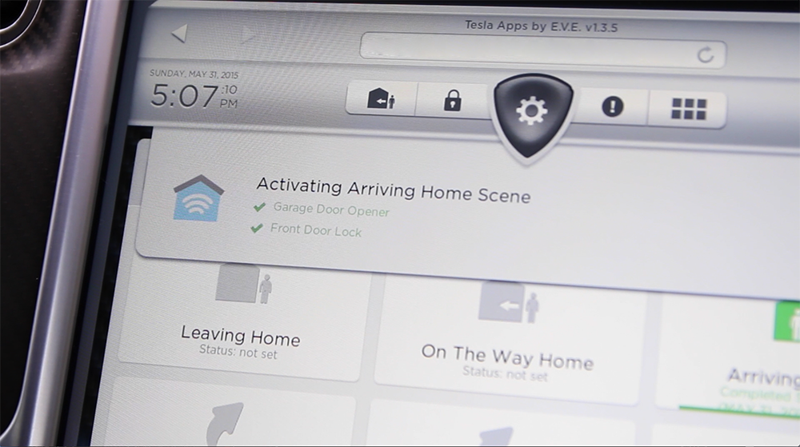
Notes:
EVEConnect allows for GPS based automations that function across multiple Smart Home platforms, enabling devices to work together through geofencing. We will use this same functionality across smart city and additional IoT devices.

Slide 8






EVEConnect supports the top North American consumer Smart Home platforms including compatibility with approximately 500+ Smart Home devices and services

Slide 9

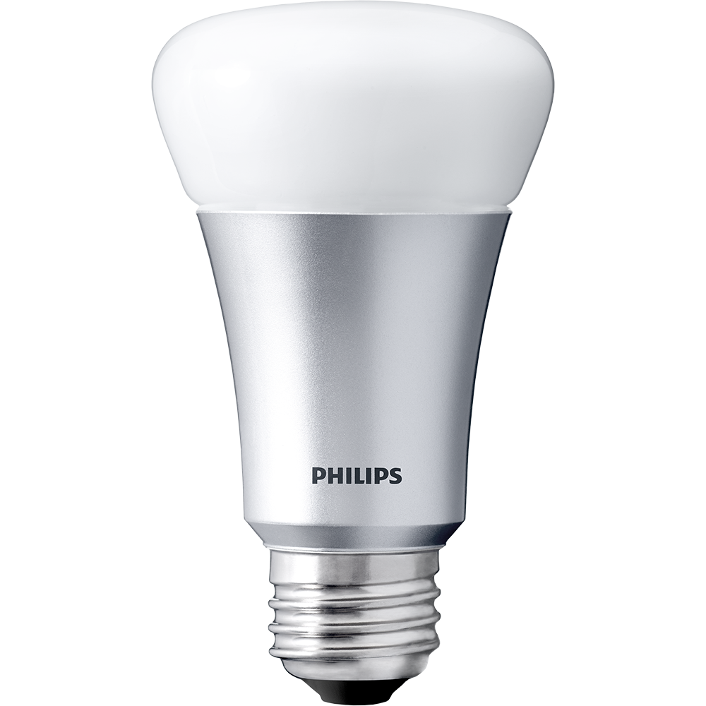

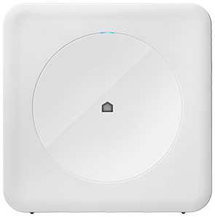
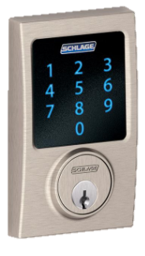

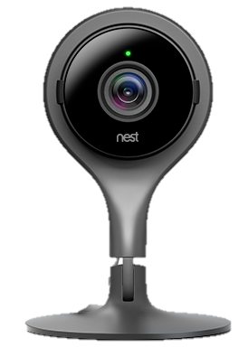
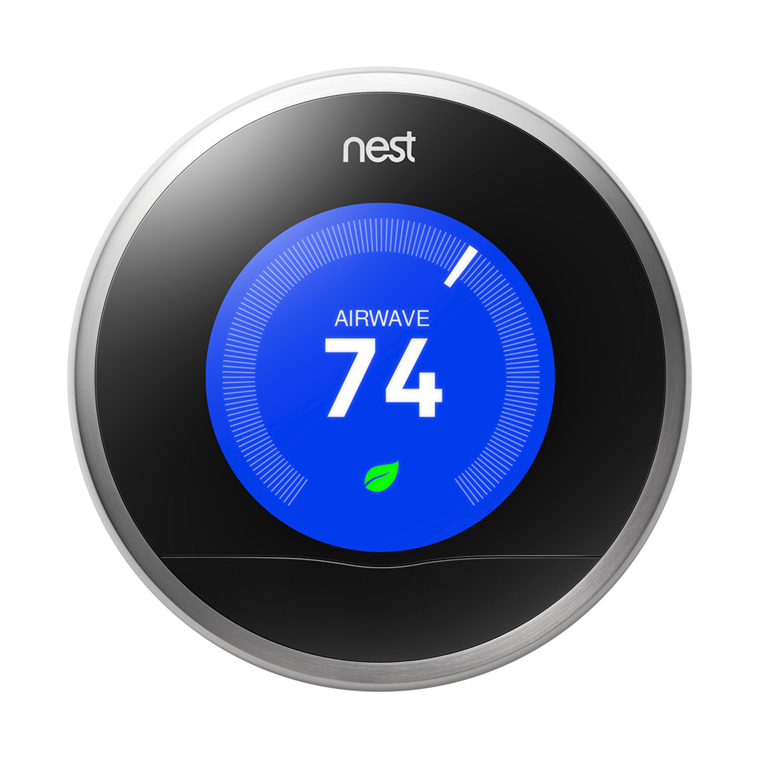
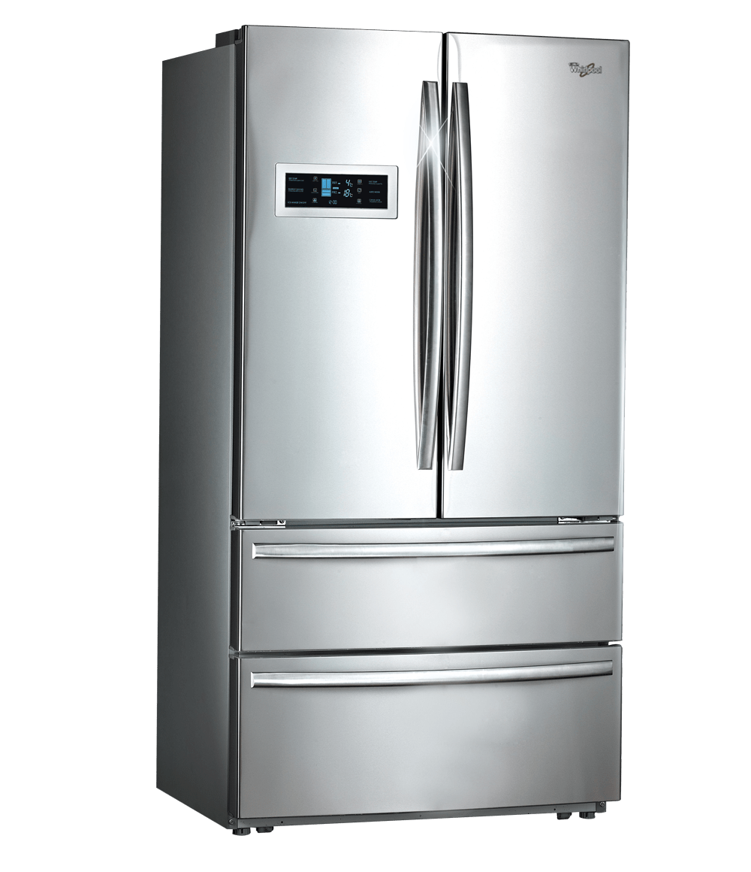

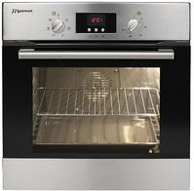





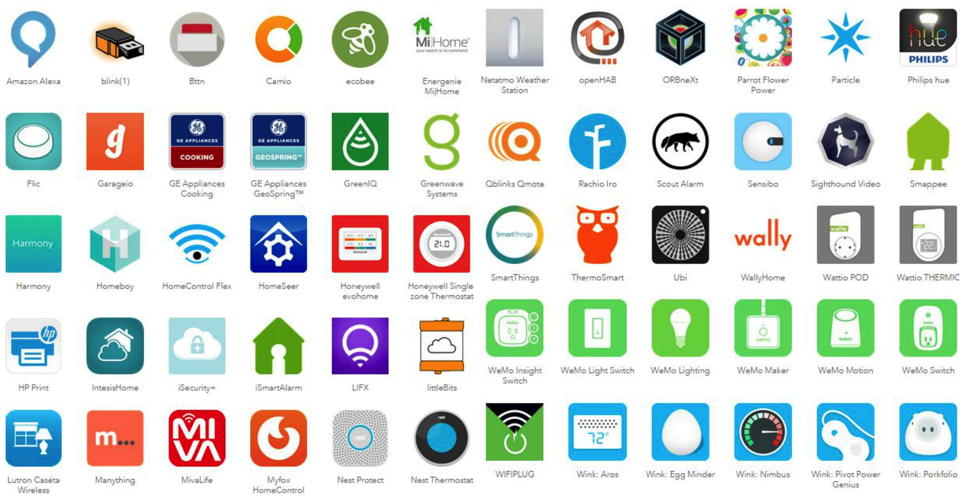
EVEConnect
Internet
Vehicle head unit
Over 400+
Supported Devices
Notes:
EVE was built on technologies that allow for quick development in multiple environments. This means that an OEM can be running Android, QNX, Mirrored solutions and more, we are able to adapt our solution quickly and cost effectively…EVE has developed for many of these applications and are constantly evolving.

Slide 10
EVE is Perfectly Positioned at the Meeting of Multiple Industries

Slide 11




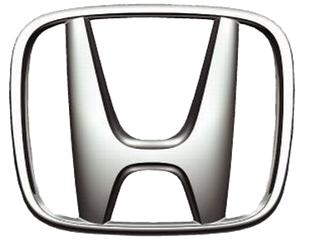







Slide 12
Warren Butland
EVP & Co-Founder
EVOLVED VEHICLE ENVIRONMENTS
613-292-2793
warren@eve.solutions
www.eve.solutions
www.teslaapps.net

