Slide 1
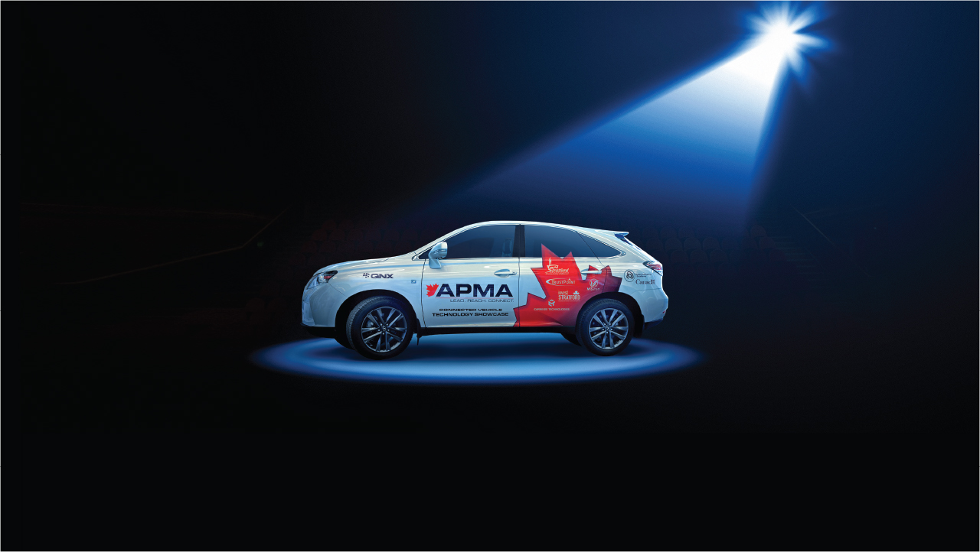
Stratford’s unique municipal-wide broadband network, reputation for innovation and strengths in IT and automotive make it the ideal real-life location to demonstrate new autotech in a living lab environment.

Slide 3
Connected Capital of Canada
IT and Autotech
Cluster
One of the only communities in North America to feature 30-square kilometre Wi-Fi connectivity along with upgraded security and data collection able to handle a range of connected vehicles.
Located in the 2nd largest IT cluster in North America, Ontario’s largest IT cluster and North America’s largest automotive cluster. Stratford’s business ecosystem includes leading advanced manufacturing, automotive and aerospace companies.
Connected Corridors
Digital Media Hub
The University of Waterloo Stratford Campus offers unparalleled digital media and business programs that advance UX, research and commercialization. The Stratford Accelerator Centre launches tech entrepreneurs and digital media companies.
Centrally located within major Canada-US trade corridors and directly connected to the Toronto-Waterloo Technology Corridor which has 15,000 tech companies, 200,000 tech workers and 5,200 tech start-ups.

Slide 4
Autonomous Vehicle Innovation Network
$80 million for investments in Connected & Autonomous Vehicle technology.
Stratford is the Provincially recognized Demonstration Zone for all technology developed in Ontario.
Stratford is making Vehicle-to-Infrastructure (V2I) investments in DSCR; LTE; 5G
Project Partners will include Automotive Supplier to Original Equipment Manufacturer (OEM) customers, software and hardware firms in IT and Advanced Electronics suppliers with commercial offerings

Slide 5
The Future
Industry Attraction & Partnerships
Rolling fleet of 10 Ontario OEM-Sourced Vehicles on City of Stratford streets
Academic Achievements & Talent Development
Waterloo Centre for Automotive Research – Engineering/Computer Science/AI
Autonomous City-Owned Assets – buses, utility vehicles

Slide 6
“‘Why Stratford?’ The key answer is leadership — you have a mayor and municipal council who decided years ago they were going to invest in city-wide Wi-Fi.”
Flavio Volpe, President, Automotive Parts Manufacturing Association, Toronto Star, 2016
“Stratford is the connected capital of Canada... it’s a smaller city that has truly invested in a connected infrastructure.”
Grant Courville, Director of Product Management, QNX Software Systems, Ottawa, Toronto Star, 2016
“ The City of Stratford was essential to the success of our autonomous driving project at Renesas.”
John Buszek, Segment Marketing Manager, RENESAS, ADAS Solutions, Automotive Unit, September, 2017
“It gets exciting because you are bringing together businesses and industries that did not coexist before. Stratford can be one or all of those things, depending on the partners they can develop.”
David Paterson, Senior Vice President for Corporate and Environmental Affairs, GM Canada, Toronto Star, 2016
Mayor Dan Mathieson
City of Stratford
519-271-0250 x236
dmathieson@stratford.ca
Joani Gerber
Chief Executive Officer
519-305-3055 x1011
jgerber@investstratford.com

