Slide 1
Creating Policies for a New AV World
The 3rd Annual Ottawa AV Summit
April 2018

Slide 2
The future of motor vehicles
In the coming years, vehicles with fully automated capabilities will be on Canada’s roads.
Vehicle manufacturers expect to have automated vehicles available for purchase in the early 2020s.
Automated vehicle testing is already happening on Ontario’s roads.
By the 2050s, automated vehicles will comprise more than 80% of new vehicle sales.
Source: IBC graph with data from Victoria Transportation Policy Institute.

Slide 3
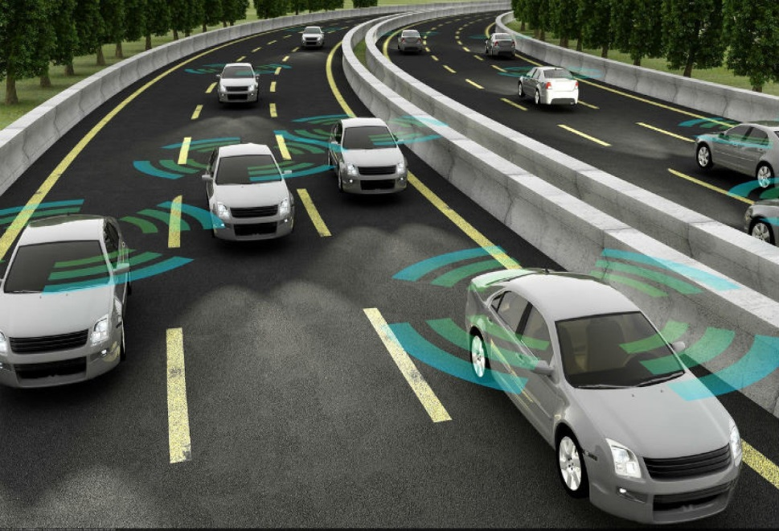
How this will affect auto insurance
Automated vehicles will change underwriting, pricing, sales, distribution and claims management.
There will be fewer but more expensive collisions.
There will be fewer people owning vehicles and more people using vehicle- or ride-sharing services.
There will be a shift in the party responsible for collisions from the human driver to the automated technology.

Slide 4
Change in party responsible for a collision
With automated vehicles coming to Canada’s roads, are the provincial auto insurance laws adequate?
Human error is the primary cause of more than 90% of collisions.
Automated vehicles will shift this distribution to the vehicle’s manufacturer and/or the technology provider.
There will likely be more product liability claims.

Slide 5
A need for a new auto insurance product
Product liability claims are more complex and take longer to settle than vehicle collision liability claims.
Currently, vehicle liability coverage is based on human error, not product malfunction.
Reforms to the insurance laws are needed to ensure that people injured in collisions caused by automated vehicles receive timely compensation.
The U.K. government is trying to solve this problem by making auto insurance compensate people injured if the automated technology caused the collision.

Slide 6
A Canadian auto insurance solution
Establish a single insurance policy and a data-sharing arrangement.
Single Policy
The automated vehicle’s insurer would compensate injured people if the human operator or automated technology caused the collision.
Subject to a deductible, the insurer could recover from the manufacturer any liability payments associated with the automated technology.
Data-Sharing Arrangement
Between insurers and manufacturers.
The data sharing would help determine a collision’s cause and facilitate the liability claim and any recovery proceedings.

Slide 7
A need for new vehicle safety standards
Develop federal vehicle safety standards for automated vehicles.
U.S. government released new voluntary guidance for automated vehicles’ development and deployment.
The guidance covers 12 priority safety design elements, such as cyber security, human-machine interface and collision data recording.
Voluntary guidance is appropriate given the need to encourage innovation.

Slide 8
Thank you
IBC Contact Information
Ryan Stein
Director of Policy
Strategic Initiatives
rstein@ibc.ca
416-362-2031 ext. 4373

