Slide 1

Autonomous Vehicle Initiatives at The City of Calgary
April 4 2018

Slide 3

Notes:
To give you a bit of background why we are here today.
At May T&T we brought forward the future of Transportation report which looked at a variety of technologies and trends and how they might shape Calgary.

Slide 4
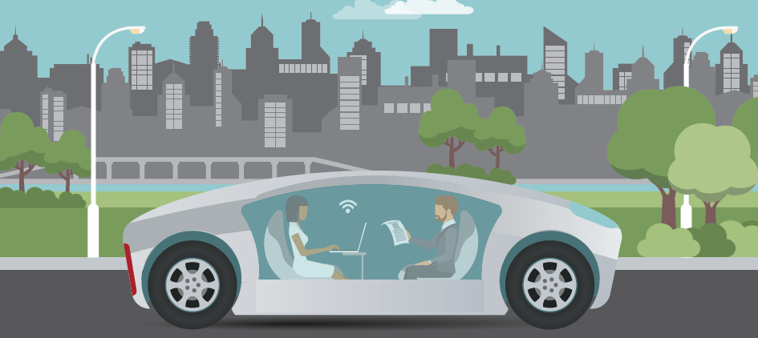

Autonomous Vehicles
Notes:
One of the technologies we focused on in the report was autonomous vehicle technology.
There were a number of speakers from industry and academia at the meeting. A speaker from an autonomous vehicle supplier company suggested that Calgary could be well suited as an autonomous vehicle testbed and that “A lack of on road testing is a barrier to the industry.”
One of the issues with on street testing is that it falls under provincial jurisdiction.

Slide 5
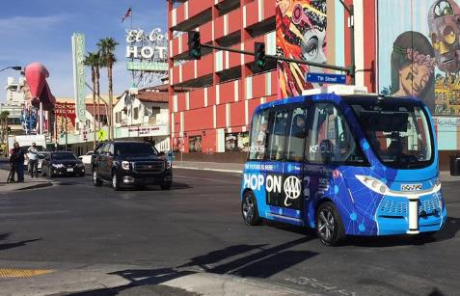
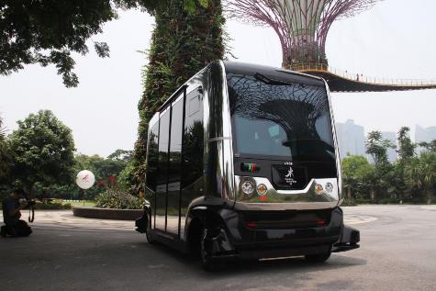
Las Vegas and Singapore Experience
Introduced the technology to the public
Brought in tourists
Helped solve last mile problems
Helped with future planning efforts
Branded the City

Slide 6
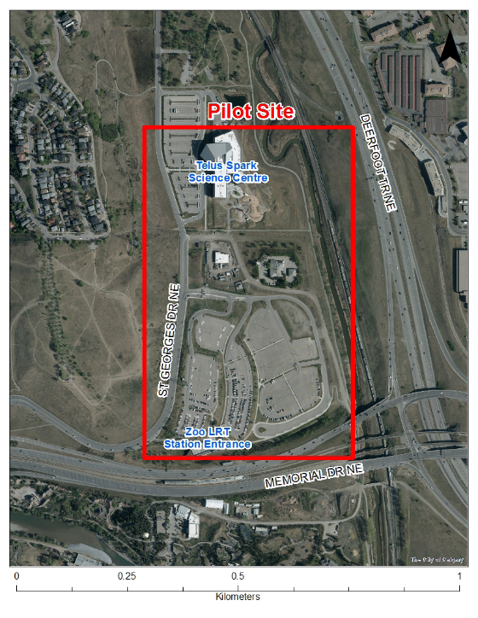
Pilot is expected to last 1 month in September 2018
1 km each way
Route will be segregated from traffic and pedestrians
Additional City Goals:
Understanding AV legislation with the Provincial and Federal Government - case study to deal with legal hurdles
2. University research + showcase Alberta’s talent

Slide 7







Slide 8
Economic Development in the tech sector

Slide 9
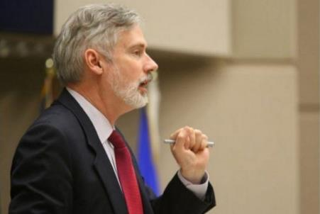
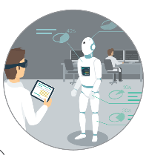
Economic Angle
How do we support the tech industry in Calgary?

Slide 10
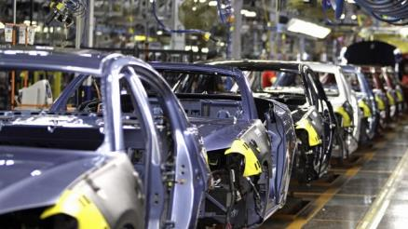

Niche for Autonomous Vehicles
Ontario
Ford announced that it will be investing $337.9 million to open a research engineering center in Ottawa
Companies are sponsoring universities in order to train highly skilled people in AV fields
Silicon Valley – Surrounding Areas
Supports the major tech companies and universities
Supports start ups and related industries such as battery manufacturing
Notes:
The niche is important because it attracts companies and helps develop industry.
For example – Ontario specializes in vehicle manufacturing and the university of waterloo is a hotbed for Artificial Intelligence research.
The Ontario Government wanted testing in Ontario so companies could do testing locally, and not have to go down to Michigan. Some of the benefits attributable to their testing program include companies like Ford building research centres and companies sponsoring universities to train specialized workers.
And in Silicon Valley – states adjacent to the tech hub are allowing testing to help strengthen and support the major tech industries, universities and create a cluster that attracts related companies like battery manufacturers
So what is Calgary’s Niche? We are not a major auto manufacturer and we are not headquarters to major autonomous vehicle developers like google.

Slide 11
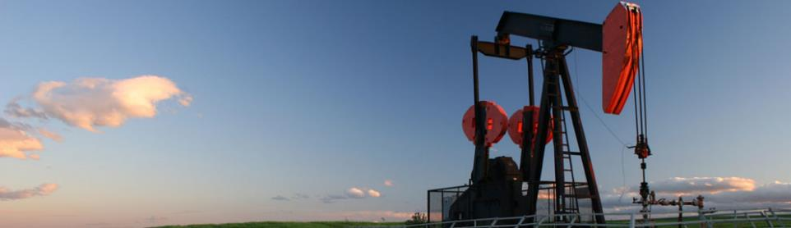
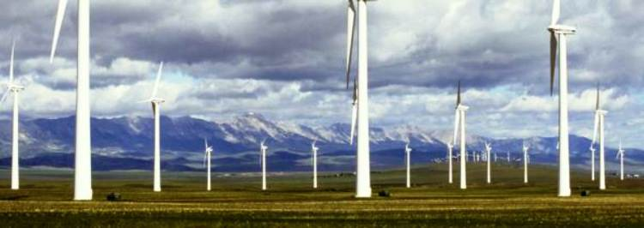
What is Calgary’s niche for Autonomous Vehicles?
Notes:
So what are we good at? Drumroll
We are really good at energy and especially oil and gas.

Slide 12
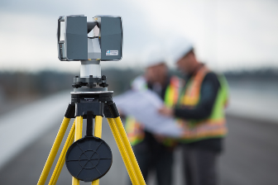
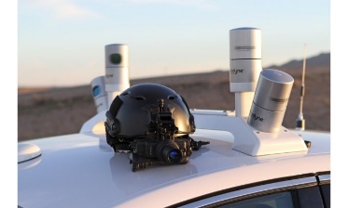
What is Calgary’s niche for Autonomous Vehicles?
Geomatics - the branch of science that deals with the collection, analysis, and interpretation of data relating to the earth's surface.
Notes:
But more specifically we lead the field in a lot of the technologies associated with the energy sector. One of fields that we are world class in is Geomatics, which is the branch of science that deals with the collection, analysis, and interpretation of data relating to the earth's surface.
It turns out that the collection, analysis and interpretation of geospatial data is really important for another type of technology. Autonomous vehicles. From research and talks with companies this type of skill set is in high demand and low supply for the autonomous industry.
Anecdotally, talking with Nevada and Contra Costa they said Geomatics was one of the key areas where companies needed help

Slide 13
Autonomous Systems
Sensing
(Geomatics, mapping, data collection)
Cognition
(Artificial Intelligence, situational awareness, decision making)
Actuation
(performing the task)
Notes:
Geomatics falls under the umbrella of what is called autonomous systems. There are 3 main components to autonomous systems:
Sensing – deals with data capture
Cognition – using that data to make a decision
Actuation – carrying out the decision
We are strongest in the sensing part, but we do have strength in the sector as a whole.
As of June 2017, there were 2,341 establishments with about 17,200 employees in the industries related to the Autonomous Systems Cluster in Calgary.

Slide 14
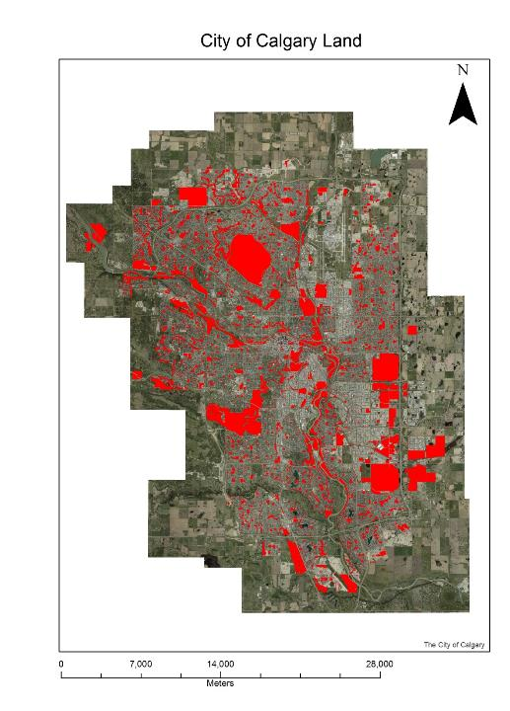
What do they need? - Industry Wish List
Roadways & City personnel
Parkades & personnel supporting the parkade
Traffic lights/signals staff and equipment
Parking lots
Public Parks (Open Space tests wireless communication systems)
Fleet vehicles maintenance personnel & operators & equipment
Vehicle operators & maintenance staff
Police & Fire Dept personnel & training facilities
Notes:
We asked industry to come up with a wish list for our assets. Here are the things they want from us. Some of the asks are larger and more complex than others.

Slide 15
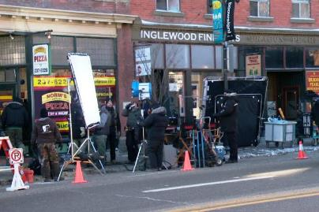
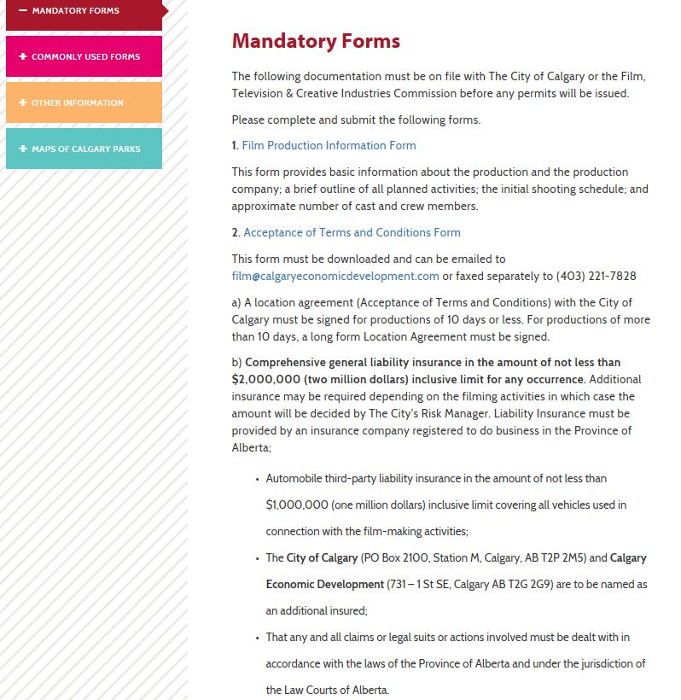
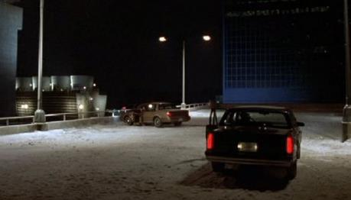
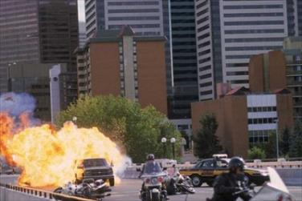
What is the best way to allow them access?
Notes:
So great. We know what industry wants, except this seems like it might be complicated navigating various City processes, and we do not want to be burdensome with a new initiative or process – so we sat down with law and risk and told them about the situation. They stated that we currently have a process in place to give industry access to assets,
Not the tech industry, but film. Calgary Economic Development has a filming intake process that processed 400 filing applications last year about which half used City assets.
When we met with the film team from CED, they said the process took a number of years to perfect, but they are at the point now where the film industry states CED have one of the best processes in North America – and more importantly a process better than Toronto or Vancouver.
The existing filming process also includes the region, so if a company wants to film outside Calgary, the process is set up for that.

Slide 16
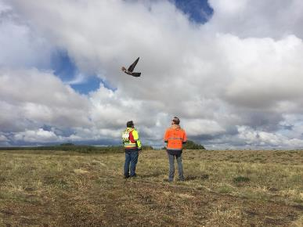
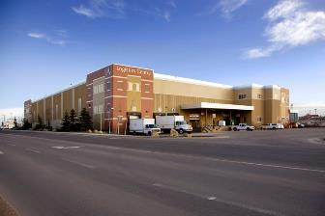
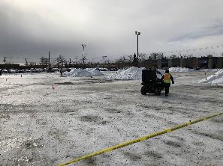
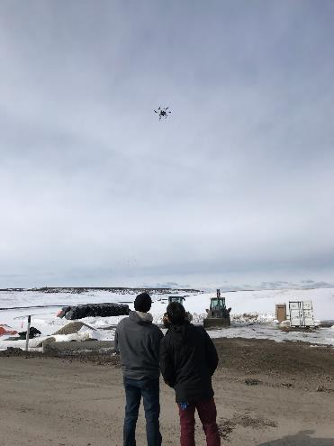
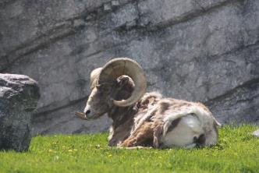
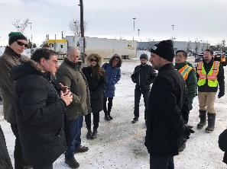
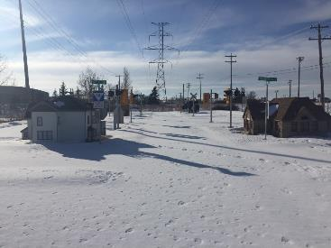
Examples of Testing this year

Slide 17
Thank you!
April 4 2018

